Slide 1
Innovation
Innovation can be simply defined as a "new idea, creative thoughts, new imaginations in the form of a device or a method".
However, innovation is often also viewed as the application of better solutions to
meet new requirements, unarticulated needs, or existing market needs.
Thinking outside the box

Slide 2
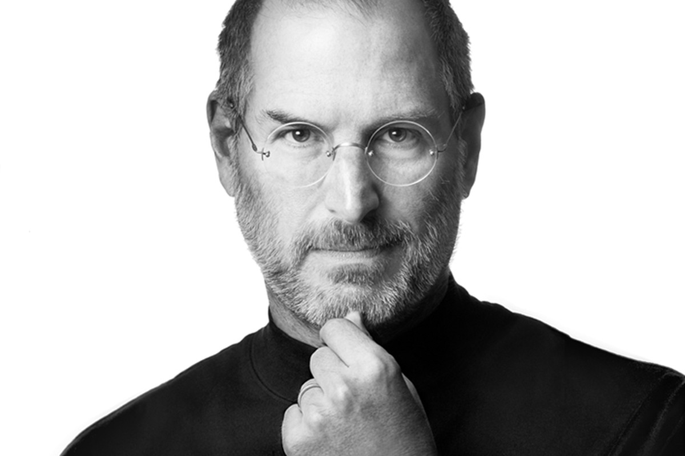
He demystified the computer and brought it to street level and started the personal computer revolution
He also did this

Slide 3
INNOVATION
INNOVATION
INNOVATION
INNOVATION
INNOVATION
INNOVATION
INNOVATION
INNOVATION
INNOVATION
INNOVATION
INNOVATION
INNOVATION
INNOVATION
INNOVATION
INNOVATION
INNOVATION
INNOVATION
INNOVATION
INNOVATION
Introduced fonts to the computer
After attending a course in calligraphy after he dropped out of college

Slide 4
My encounters …………… in relation to my CV

Slide 5
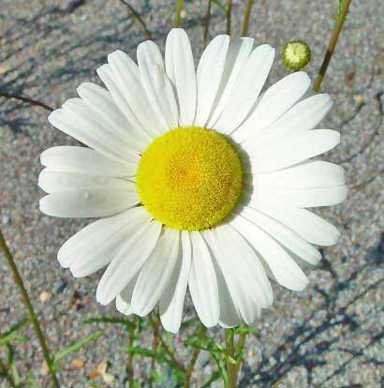

Slide 6
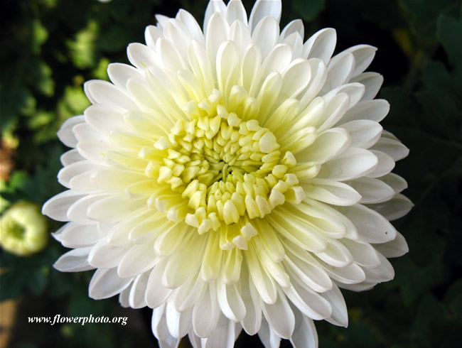
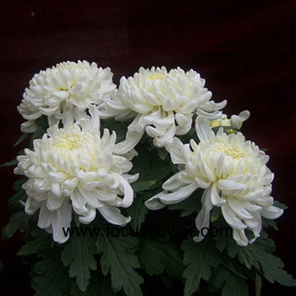
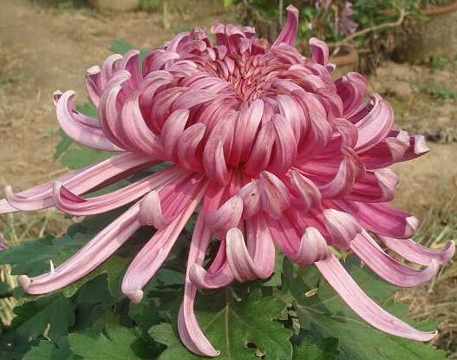
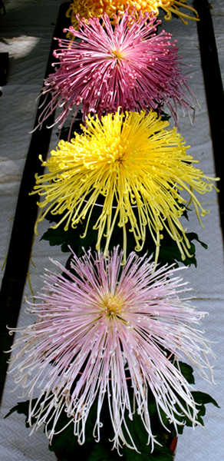
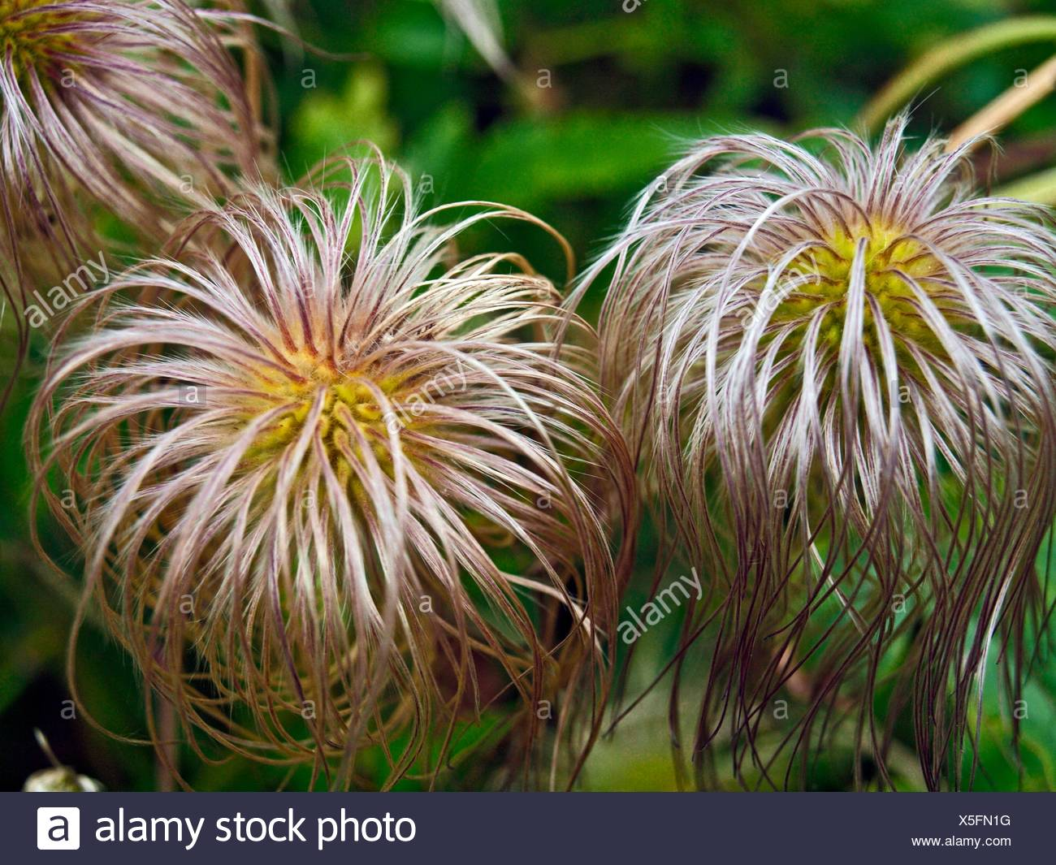
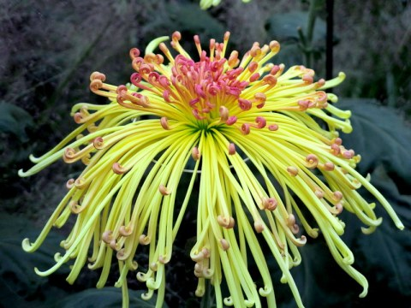

Slide 7
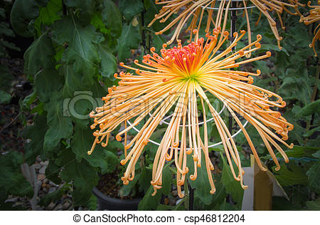
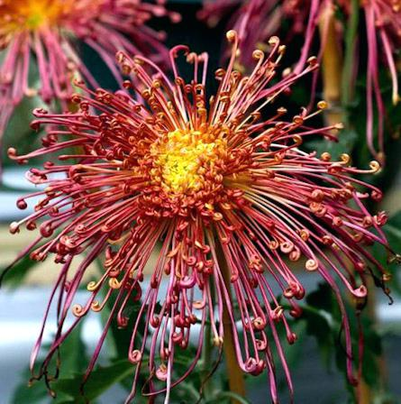
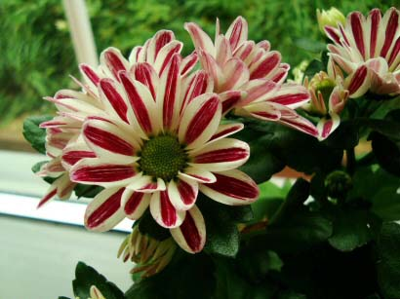
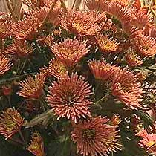
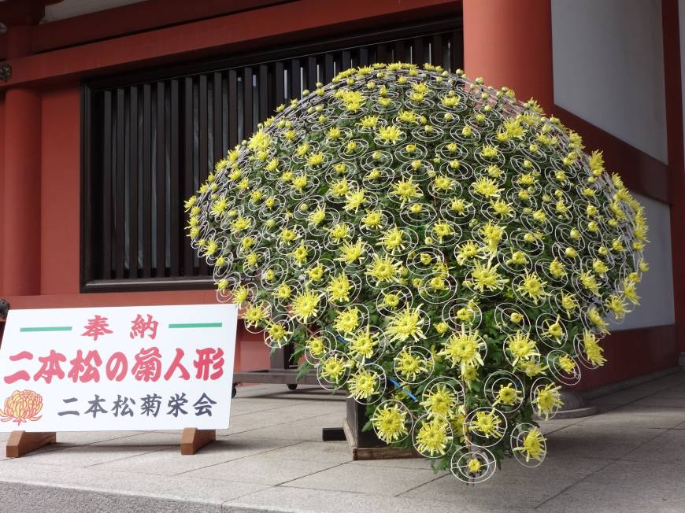

Slide 8
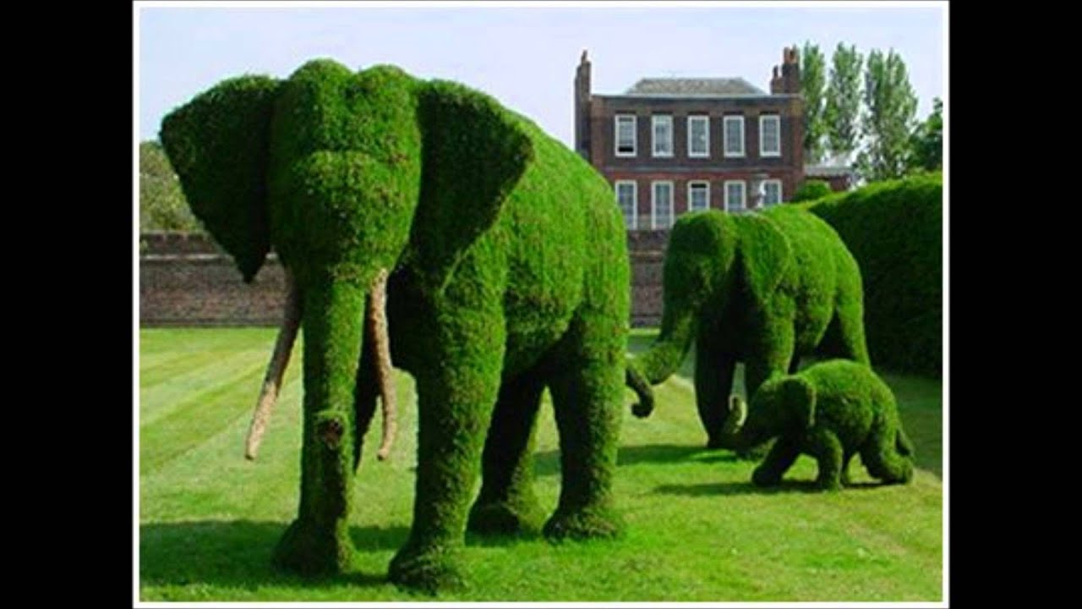
Topiary

Slide 9
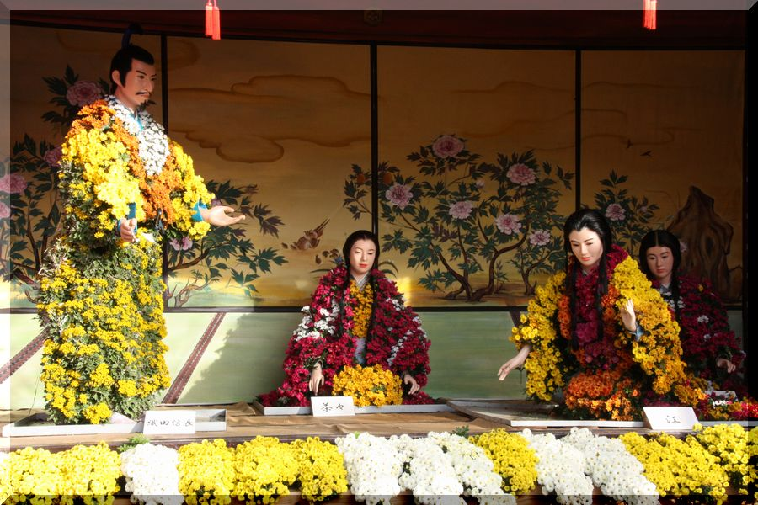

Slide 10
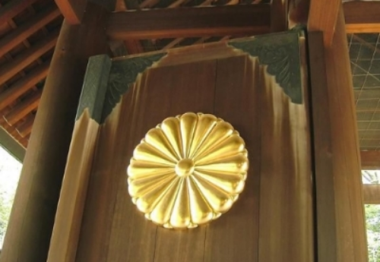

Slide 11
Innovation in its modern meaning is
a "new idea, creative thoughts, new imaginations in form of a device or method".
Innovation is often also viewed as the application of better solutions to meet
new requirements, unarticulated needs, or existing market needs. Wikipedia

Slide 12
AMAZING BRAIN
The brain is 60 percent fat but it still works hard. At any given time your brain can generate
up to 25 watts of power – that’s enough to power a light bulb.

Slide 13
Thinking outside the cage

Slide 14
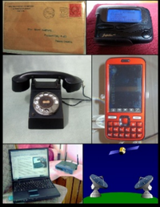
Why do we need to innovate?
The need to communicate led to the creation of different
communication devices – this is a prime example of the expression:
Necessity is the mother
of invention

Slide 16
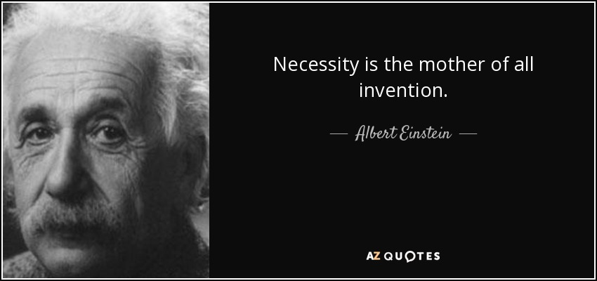

Slide 17
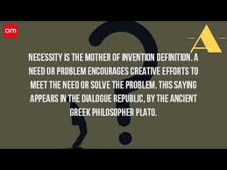

Slide 18
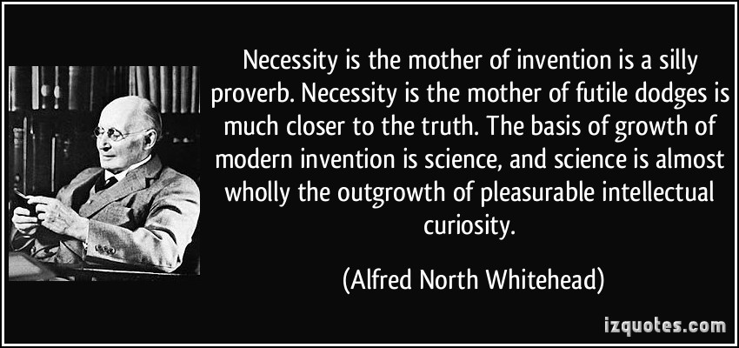

Slide 19
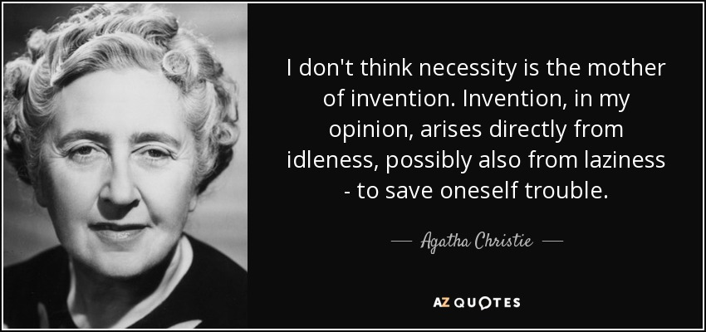

Slide 20
So, Need or necessity
Focuses on material or physical needs
Intellectual curiosity
Focuses on the pleasure of satisfying curiosity
It is more abstract and/or theoretical

Slide 21
Type | Public
Traded as | NYSE: KODK Russell 2000 Indexcomponent
Industry | Graphic arts Imaging technology Consumer products
Predecessor | The Eastman Dry Plate Company
Founded | September 4, 1888; 130 years ago^{[1]}
Founders | George Eastman Henry A. Strong
Headquarters | Kodak Tower Rochester, New York, US
Area served | Worldwide
Key people | Jim Continenza (Executive Chairman)
Products | Digital imaging, photographic materials, equipment and services
Revenue | US$1.798 billion (2015)^{[2]}
Operating income | US$2 million (2015)^{[2]}
Net income | US$16 million (2016)^{[2]}
Total assets | US$2.138 billion (2015)^{[2]}
Total equity | US$103 million (2015)^{[2]}
Number of employees | 5,800 (2018)^{[3]}
Website | www.kodak.com

Slide 22
The Eastman Kodak Company (referred to simply as Kodak /ˈkoʊdæk/) is an American technology company that produces camera-related products with its historic basis on photography. It is best known for photographic film products.
Kodak was founded by George Eastman and Henry A. Strong on September 4, 1888. During most of the 20th century,
Kodak held a dominant position in photographic film. The company's ubiquity was such that its "Kodak moment" tagline
entered the common lexicon to describe a personal event that was demanded to be recorded for posterity.^{[8]}
Kodak began to struggle financially in the late 1990s, as a result of the decline in sales of photographic film and its slowness in transitioning to digital photography.
As a part of a turnaround strategy, Kodak began to focus on digital photography and digital printing, and attempted to generate revenues through aggressive patent litigation.
In January 2012, Kodak filed for Chapter 11 bankruptcy protection in the United States District Court for the Southern District of New York.

Slide 23
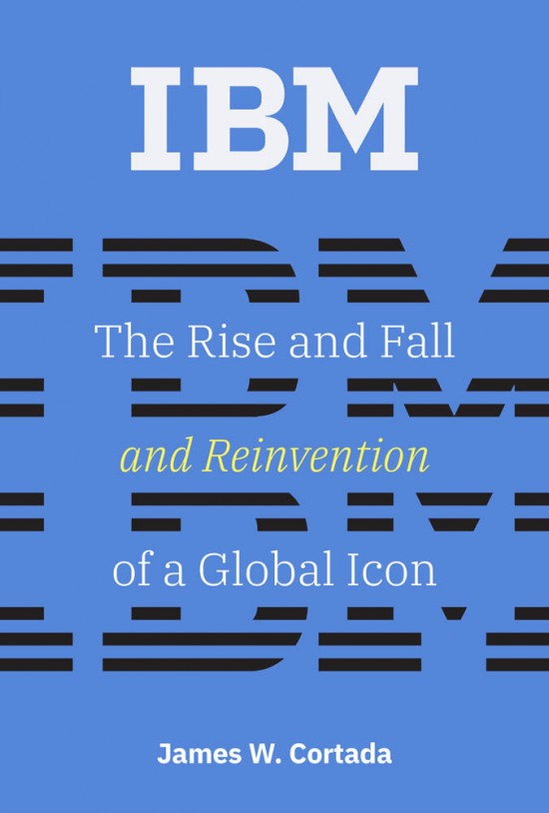
A history of one of the most influential American companies of the last century.

Slide 24
The message here is quite simple
Innovate or fail
Adapt or fail
Be awareness of the environment or the marketplace

Slide 25
Will Sri Lanka ever be known for innovation?
Mazin Hussain – June 25 2018
“It’s just a balloon with icing. We don’t have the f***ing cake yet,” said Mangala Karunaratne – Founder & CEO of Calcey Technologies.
I had asked him whether Sri Lanka actually was an innovative nation.
“While we do have innovative companies, as a nation we can’t pride ourselves on being known for innovation just yet”.
One of the panelists was Dr. Harsha Subasinghe – Founder & CEO of CodeGen.
He shared that our ancestors were innovators. They built amazing things that we’ve yet to fully understand.
But over the past few centuries, we’ve lost these skills. And today, we are in
stagnation.

Slide 26
Heminda Jayaweera – the co-founder of Venture Frontier Lanka, echoed similar statements. He believed that Sri Lanka should specialize in a particular area of technology. Furthermore, he emphasized the need to promote entrepreneurship beyond Colombo. “But if you wait for the government to provide everything then nothing will happen,” stated Heminda.
He attached the following telling photograph to stress his viewpoint

Slide 27
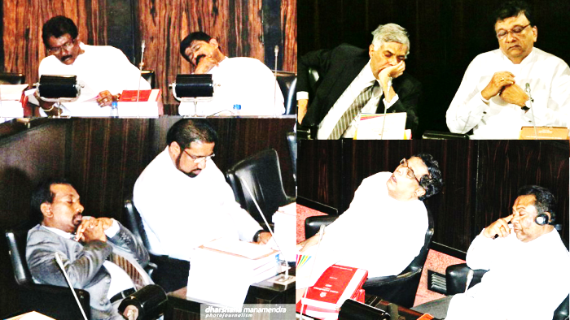
I generously call it deep thought but others may call it deep s..t

Slide 28
Tue, 19 Mar 2019
Sri Lanka climbs two places in latest innovation rankings
12 July 2018
10:01 am
Google BookmarkFacebookMore1The Global Innovation Index (GII), a collaboration between Cornell University, INSEAD and the World Intellectual Property Organisation (WIPO), placed Sri Lanka at the 88th position, out of 126 countries in its 2018 edition, up from 90th place in 2017.
Sri Lanka has made two-position improvement in the 2018 innovation rankings as
the country made some limited progress in general infrastructure, ecological
sustainability and knowledge and technology outputs, supporting such innovation
The slow progress in the index rankings reflects Sri Lanka’s weak political and regulatory environment, poor spending and performance in human capital and research and difficultly in accessing the credit in funding innovations – the same criteria which fared poorly even in 2017.

Slide 29
Historically what can Sri Lanka be proud of in terms of innovation
on a global scale?
1. Dedicated buildings and surroundings for illness - hospitals
2. The hydraulic civilization – damming of rivers, building of tanks,
control of water flow (irrigation) for agriculture
3. The architecture of the Chaitya or Daagoba

Slide 30
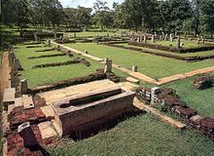
Mihintale Hospital
Mihintale Hospital is the oldest in the world. Ruins of ancient hospitals in Sri Lanka are still in existence in Mihintale, Anuradhapura, and Medirigiriya.
Ruins of a two thousand years old hospital were discovered in the historical city of Anuradhapura Mihintale Sri Lanka
There are 2 innovations here.
According to the Mahavamsa, the ancient chronicle of Sinhalese royalty, written in the sixth century CE, King Pandukabhaya of Sri Lanka (reigned 437 BCE to 367 BCE) had lying-in-homes and hospitals (Sivikasotthi-Sala) built in various parts of the country. This is the earliest documentary evidence we have of institutions specifically dedicated to the care of the sick anywhere in the world.^{[14][15]} Mihintale Hospital is the oldest in the world.^{[16]} Ruins of ancient hospitals in Sri Lanka are still in existence in Mihintale, Anuradhapura, and Medirigiriya.^{[17]}
One is to bring sick people to a central location for more efficient management
The next is to have common facilities, also for more efficient control.

Slide 31
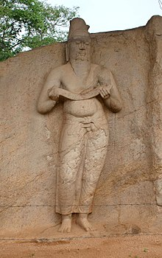
Parākramabāhu I (Pali Mahā Parākaramabāhu 1123–1186) was king of the Kingdom of Polonnaruwa from 1153-86. During his reign from the capital city of Polonnaruwa, he unified the three lesser kingdoms of the island, becoming one of the last monarchs in Sri Lankan history to do so. He oversaw the expansion and beautification of his capital, constructed extensive irrigation systems, reorganized the country's army, reformed Buddhist practices, encouraged the arts and undertook military campaigns in South India and Burma. The adage "not even a little water that comes from the rain must flow into the ocean without being made useful to man" is one of his most famous utterances.^{[1]}
The statue in Polonnaruwa
traditionally held to be of
Parākramabāhu the Great

Slide 32
Building such large and deep lakes brought about new challenges in controlling and handling water in a safe and non-destructive manner. The greatest problem faced was to release the stored water into earthen canals with controlled velocities while dissipating the enormous potential energy stored in the water. It was a requirement that the very earthworks that held these water needed to be protected. A breached embankment would wipe-out the entire community that lived besides it.
The first technique used was a devised called the “Keta Sorowwa” presently known as a VT sluice or a Vertical Tower Sluice. [Sorowwa – Sinhala term for Sluice] The modern-day “Moring Glory” spillway is an advancement of the Keta Sorowwa. A type of structure adopted when natural ground conditions are not favourable to site the excess water spillovers in reservoirs. The Bomburu-Ella reservoir in Nuwara Eliya, Sri Lanka on the way to Horton Plains is facilitated with a Morning Glory spill. So named as the structure depicts the shape of the Morning Glory flower.
The Keta Sorowwa is a devise formed with a number of funnel type chute units of burnt clay placed one on top of the other
to reach the water surface. This stack is connected to a burnt clay conduit placed at the bottom of the embankment leading
to the canal which distributed the water to the paddies. The theory being that… the water pressure at the top of the surface
is less and the stored energy is manageable. The surface water of the reservoir was transferred through the tower of chutes
into the canal by the clay conduit.
Once the water level of the reservoir reached the level of the uppermost chute unit the discharge ceased, and the top most
chute was removed manually, re-activating the discharge of water to the depth of the second chute. This way one could control
the water issue on a chute basis and the wastage could be monitored and managed. In an emergency the chute was to be
plugged stopping the water flow.

Slide 34
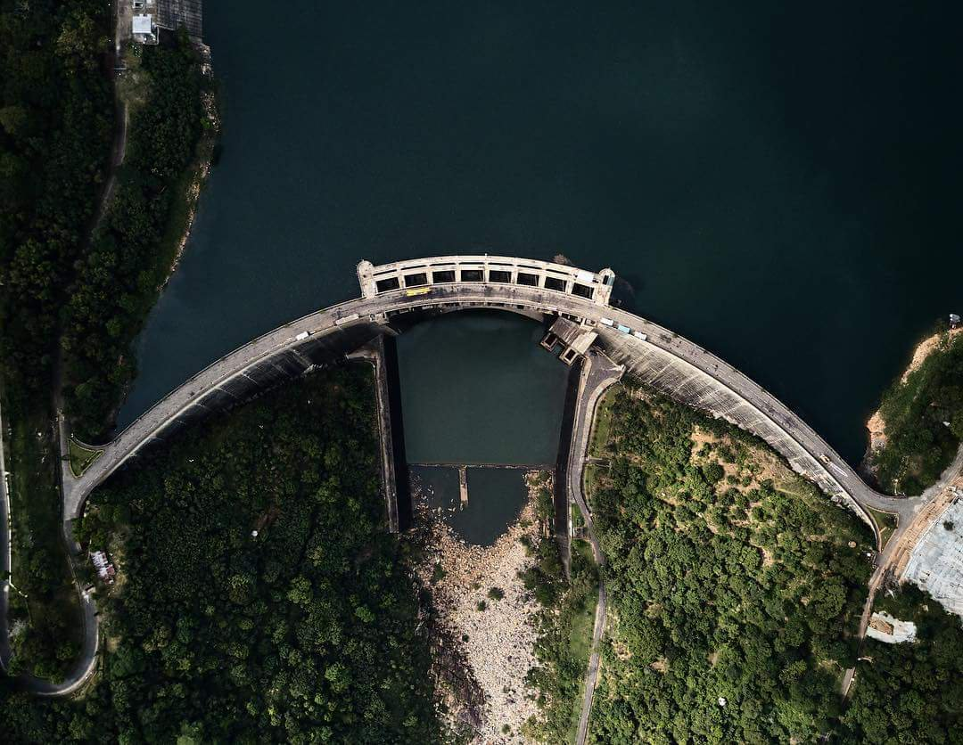
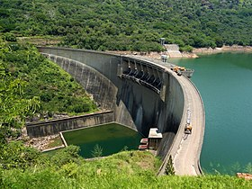

Slide 36
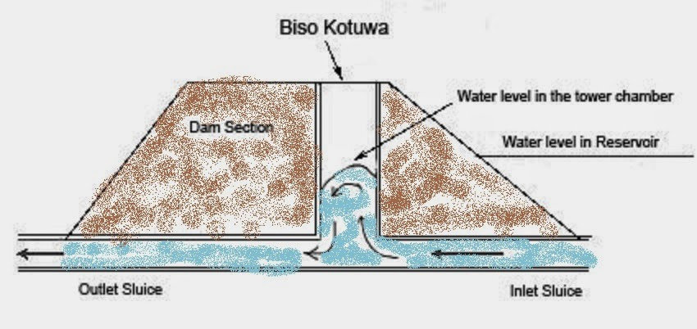
Cistern sluice

Slide 37
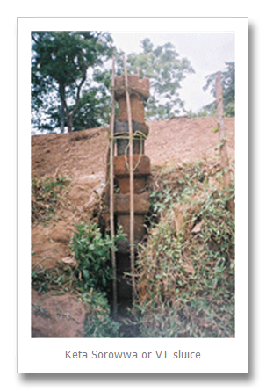
Keta sorrowwa or Vertical tower sluice

Slide 38
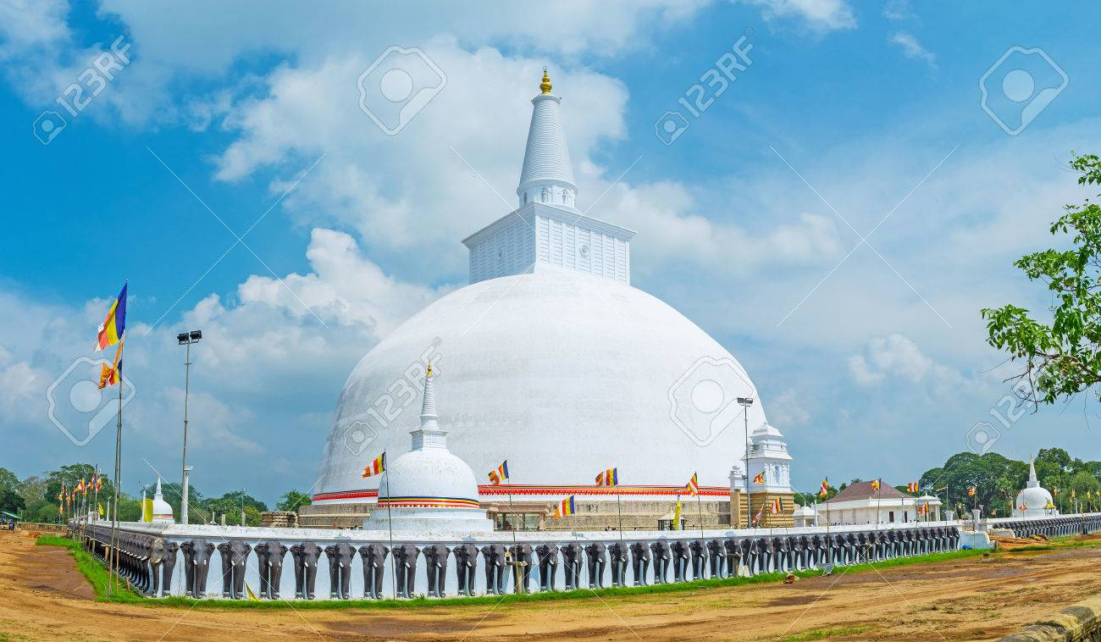
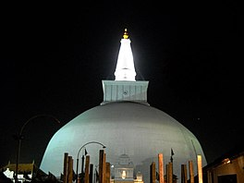
Is most of it hollow inside?
What technology did they use to
get the perfect symmetrical curvature

Slide 39
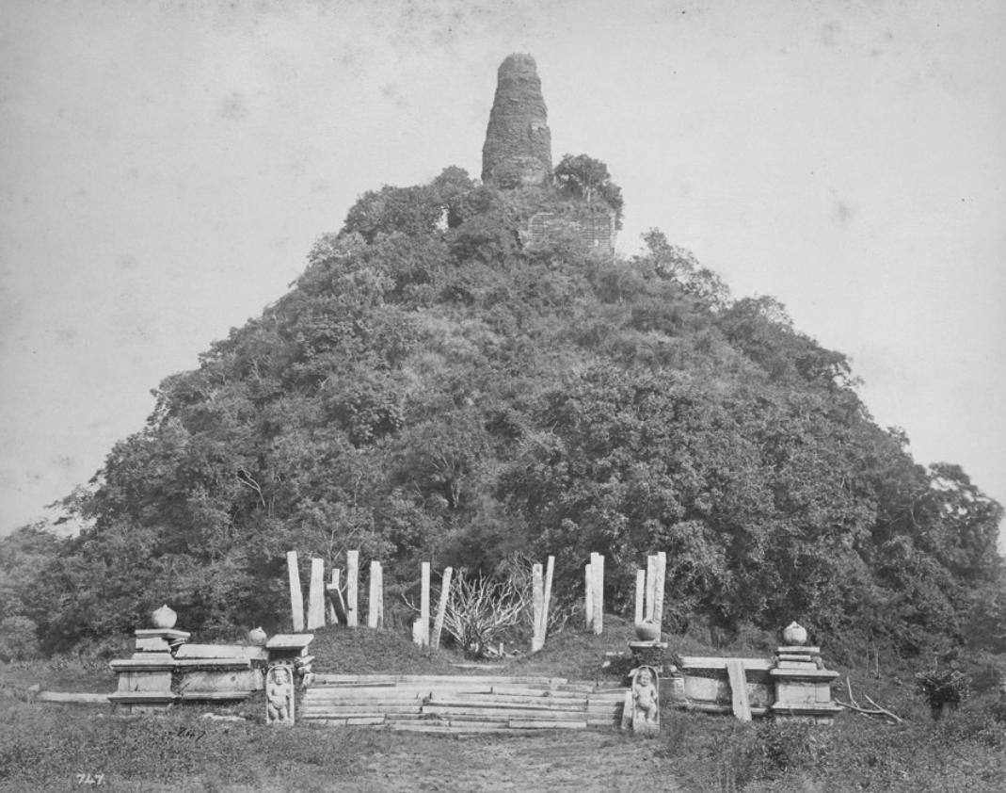
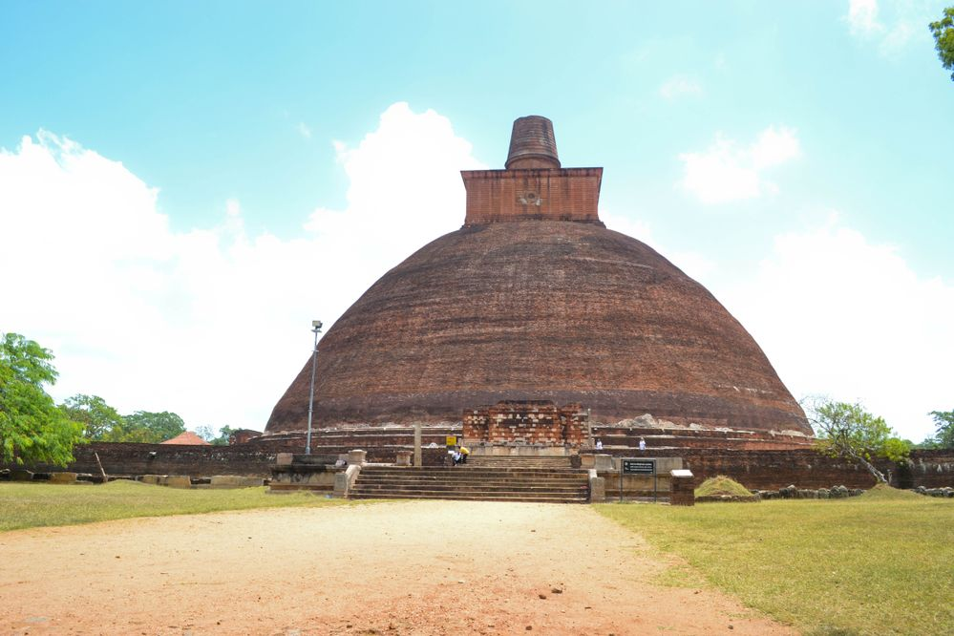

Slide 40
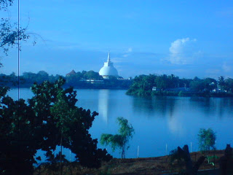
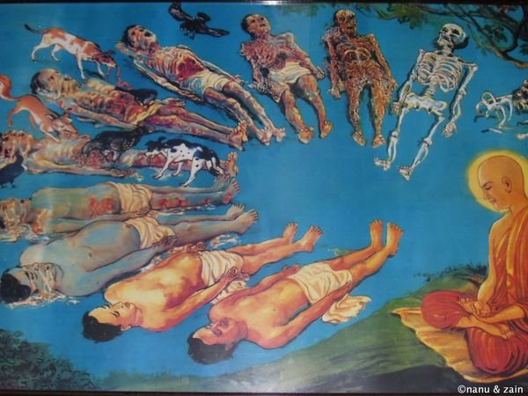
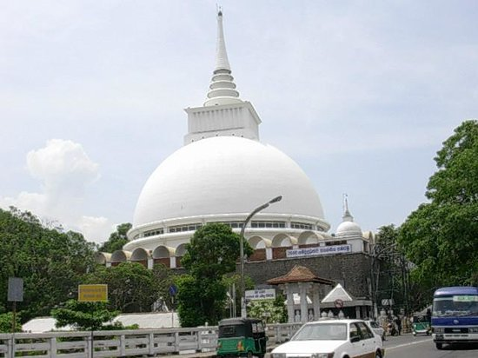
Is it hollow or solid inside?

Slide 41
Profile of Dr. Kulasingha
Vijaya Godakumbura

Slide 42
Vijaya Godakumbura
Dr Wijaya Godakumbura
Born | Pelmadulla Ratnapura District Sri Lanka
Nationality | Sri Lankan
Education | Pelmadulla Central College Pelmadulla Nalanda College Colombo Ceylon Medical College
Known for | Surgeon Founder of Safe bottle lampFoundation
Title | Vidya Jyothi
He passed his advanced level with high marks in 1959 from Nalanda College
Colombo and entered Ceylon Medical College to study medicine. In 1964 he
Completed Bachelor of Medicine, Bachelor of Surgery and passed out as a doctor.
While at Nalanda, Wijaya excelled in sport such as athletics and football.

Slide 43
Career
Later in 1970s he went to United Kingdom for further studies and training. After being specialized in the treatment of Burns, Wijaya returned to Sri Lanka and worked as a Surgeon in many hospitals.
Invention of Safe Bottle Lamp
After seeing and treating many patients who had burn injuries due to unsafe
kerosine bottle lamps he developedthe Safe Bottle Lamp in 1992. He established
the Safe bottle lamp foundation in 1998 after winning the
Rolex Awards for Enterprise.
Then in 2009 his development won the first place in The World Challenge
competition held in The Hague Netherlands.^{[2]}

Slide 44
The Foundation
Having received a Rolex Award for Enterprise in 1998, Dr. Godakumbura established the Safe Bottle Lamp Foundation (SBLF), a non-profit organization. The Foundation is governed by a board of directors and employs two full-time staff .
In addition to the Rolex Award, the foundation and Dr. Godakumbura have received a
range of other local and international awards and grants. Among these are a Lindbergh
Foundation Grant and a BBC World Challenge Award. The project has been featured in
many international publications such as TIME, Newsweek, Science and Nature,
National Geographic and La Figaro.
Dr. Godakumbura has represented the foundation in many international conferences on
burn and accident prevention as a speaker or as a participant. The foundation and the
Sudeepa lamp have been promoted as a replicable solution for other developing
countries where accidental burns due to unsafe lamps is prevalent.

Slide 45
The Safe bottle lamp, called sudeepa or sudipa for good lamp, is a safer kerosene lamp designed by Wijaya Godakumbura^{[1]} of Sri Lanka. The safety comes from heavier glass, a secure screw-on metal lid, and two flat sides which prevent it from rolling if knocked over.
History
As surgeon Dr. Godakumbura saw many burn cases caused by kerosene lamp fires. Over 1 million homes in Sri Lanka do not have electricity, and rely on kerosene lamps for illumination, often improvised lamps made from bottles. These tall lamps tip easily, and when they do, the wick holder often falls out and starts a sudden, intense fire. Often the fuel falls on a nearby person, setting them ablaze and resulting in severe burns, often fatal.
In 1992, Dr. Godakumbura set out to design a new lamp that was both safer, and inexpensive
enough to be affordable by the impoverished Sri Lankans at risk for these fires. The resulting lamp
is a small, flattened sphere, which resists tipping and rolling. It is made of thick glass to resist
breaking, and has a screw-on metal cap that holds the wick in place and prevents spilling.
In 1993, with contributions from numerous sources, including Science Fiction writer and Sri Lanka
resident Arthur C. Clarke, and the Canadian High Commission, the lamp was put into production.

Slide 46
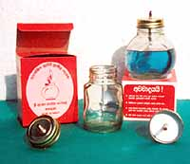
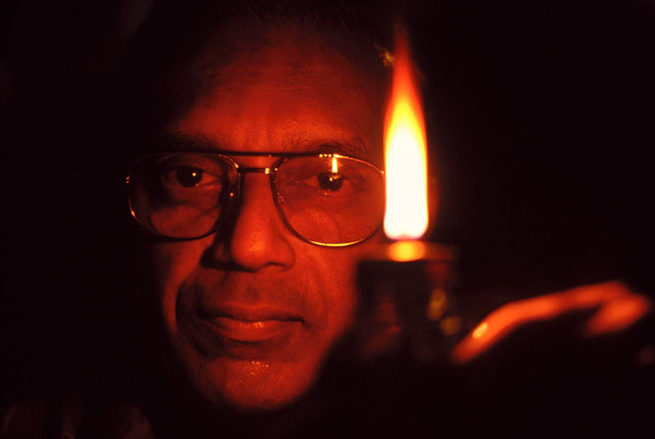
Available for a cost of less than US$0.25 each, over half a million of the new lamps have been
sold, and Dr. Godakumbura hopes to continue producing the new lamps until use of improvised
lamps drops to a small percentage of lamp use in Sri Lanka.

Slide 47
The poor man’s innovations

Slide 48
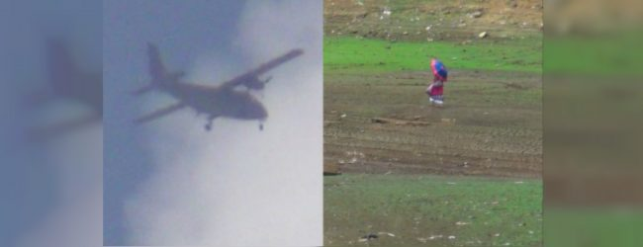
Cloud seeding pilot project brings rain
Written by Staff Writer 22 Mar, 2019 | 9:34 PM
Share:
Colombo (News 1st): Cloud seeding in Sri Lanka has proven to be a success following the implementation of a pilot project in Mousakelle today (March 22).
According to the Ministry of Power & Energy, a Y-12 aircraft flew 8000
feet above the Mousakelle to carry out cloud seeding successfully.
The ministry said after dispersing chemicals into the clouds it rained for
around 45 minutes in the respective area.

Slide 49
Innovation in ideas
All the modern theories of science were “new ideas“ at the time of their promulgation
Many were ridiculed and some new ideas were even banned or punished as they were against
the grain of contemporary thought.
Galileo, Copernicus, Pasteur, Darwin, Mendel, Einstein, Hubble
In the present day world, the word innovation is used very commonly
It is used mostly in terms of an idea or plan rather than in reference to a thing or object
As an idea is more abstract than an object the risk involved in the execution of an idea is greater.
By nature it will involve more engagement with society as the idea (abstraction) needs to be
accepted by the general public who has a lesser grasp of the concept of abstraction, especially if
the idea has no definitely visible result in the near term

Slide 50
Lets go over some familiar local history in innovation in education
In 1946, then Ceylon introduced a free education system
The word “free” was interpreted as “at no cost)” in translation from English
“At no cost” (no milay) implied that education should be available to those who could not otherwise afford it
A very noble idea indeed
It did not imply the banning of education “at a cost” for those who could afford it – so called private education.
At the time, an education that had social and economic value was provided mostly by non-secular
urban schools using a foreign based curricula with preferential use of English – at a cost
The noble idea had massive problems at the point of implementation as the curricular and language infrastructure was not in place.
This discrepancy (or defect) led to a visible difference in the quality of the product – the student.
This difference was so stark that politicians decided to ban private education and force
“free education” to the public.
The freedom to decide on the quality of your education was removed by statute.
This has resulted in the present educational mess we are in

Slide 51
Enter innovation to the field of education
Sensing the declining quality of education and the poor quality of English, market forces and
parents demanded an alternate system of education, with minimal interference from the
government bureaucracy
2. Under the prevailing BOI concessions, thus began the expensive fee levying “International schools”
system, “international” implying a more open and modern curriculum rather than a rigid
government system that did not stress the use of English – the accepted international language.
3. The country then lost the free education concept and the government did not object at all – especially as most of the politicians children were attending these schools. Many of you also may have attended these schools. They are accepted to deliver a better quality of education.
4. To add to this came the private tuition epidemic, which added to the cost of education and even disrupted the traditional
activity pattern of adolescent students. This was another blow to “free” education that society has now accepted.

Slide 52
These phenomena show that the private sector is not only more innovative but also produces a
better quality product.
Government by nature is less innovative and not concerned much about quality.
However, we must not forget that government yet has a vital place in education as it accepts and caters to the less privileged students and families.

Slide 53
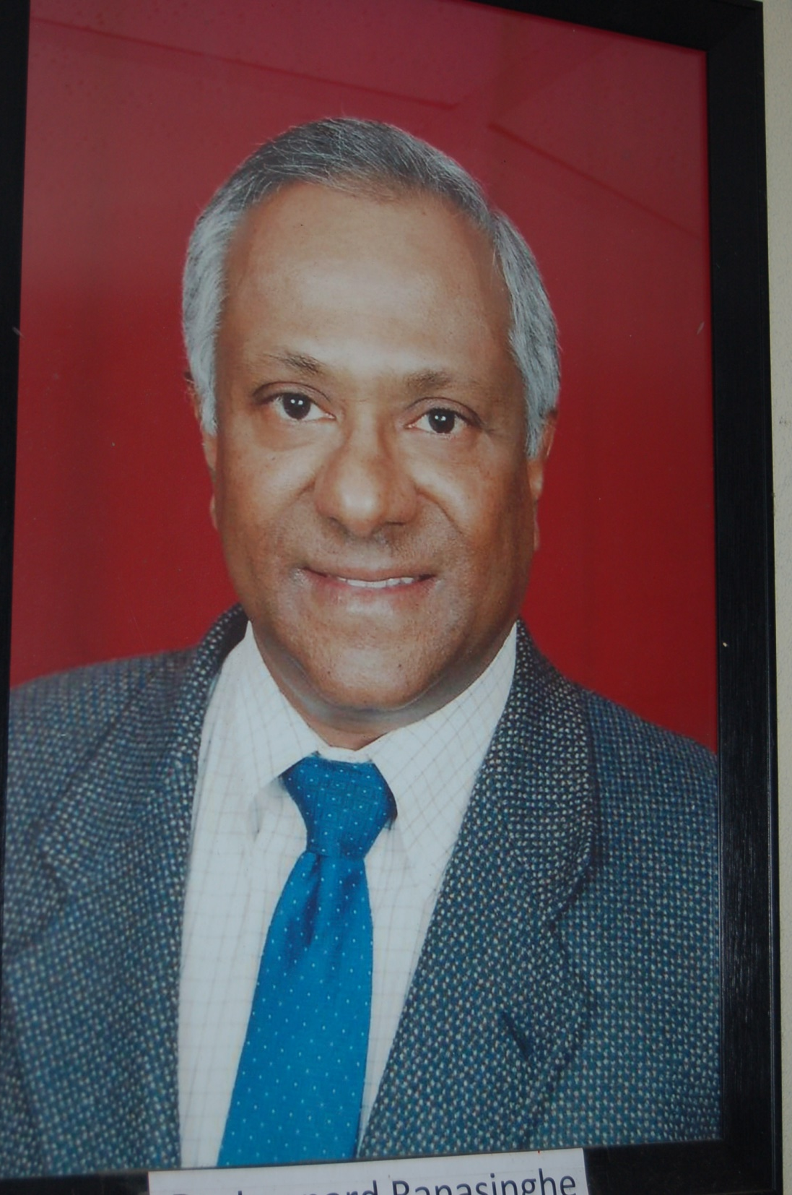

Slide 54
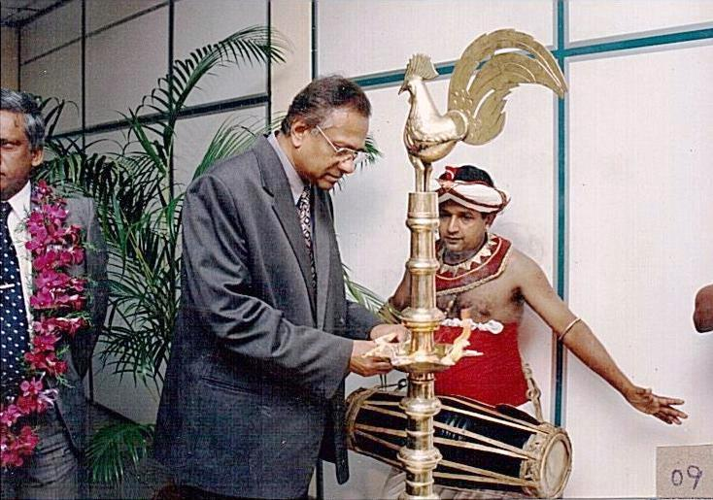

Slide 55
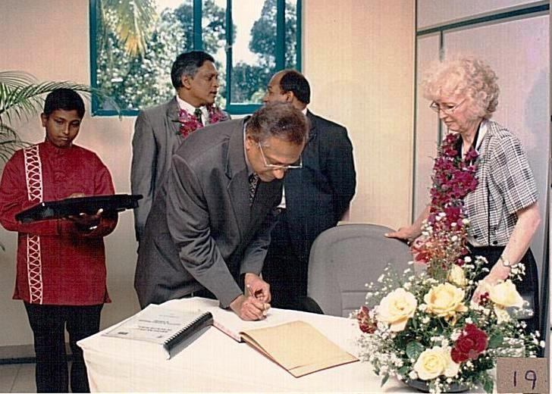

Slide 56
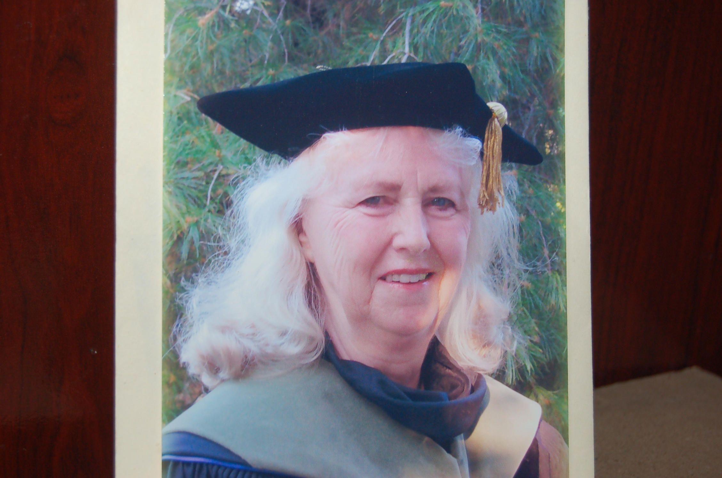
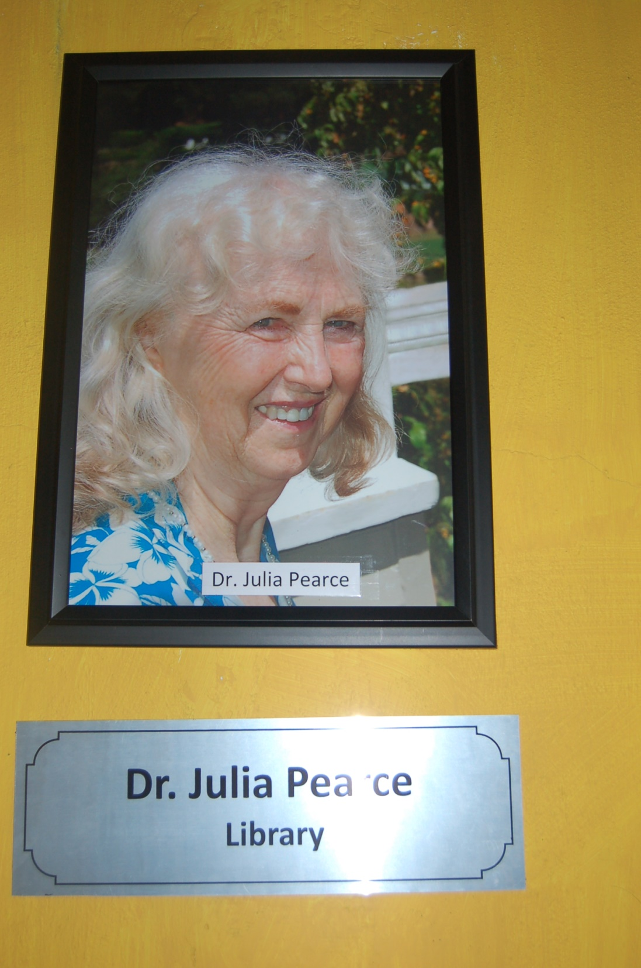

Slide 57
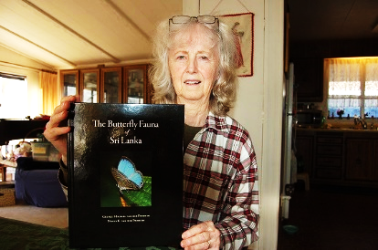

Slide 58
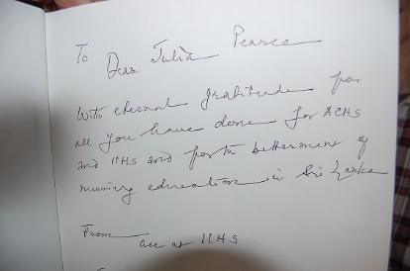

Slide 59
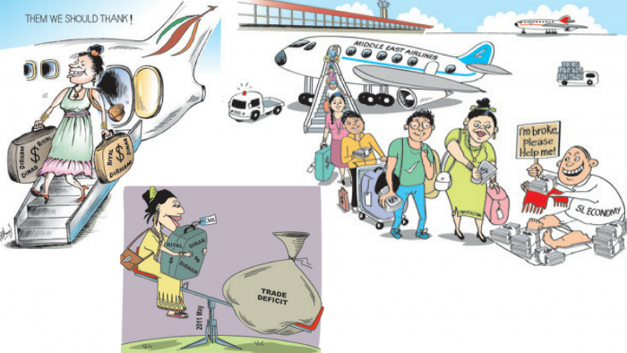
In Sri Lanka, remittances play a bigger role in the economy than we’d like (Image credits: Sunday Times)

Slide 60
Lets get closer to home – ie, to IIHS.
Are we innovative?
How and where did we start and where are we now?
We initially started in 2002 as a non-profit organization
We wanted to take pride in exporting skilled and intelligent labor rather than unskilled slave labor
for which Sri Lanka is famous
This was an unbelievable innovation to almost everybody. There was no commercial profit motive.
We were responding to a glaring (very visible) foreign market need that the government could not see or could not cater to.
We wanted to elevate professional levels (BSc, MSc, PhD) in healthcare personnel rather than keep them as drones with the basic qualification
We started with nursing and then expanded to physiotherapy, biomedical science,
administration, education and aged care.

Slide 61
We opened branch schools and showcased our mission with road shows so as to take our
mission to the people rather than inconvenience them to come to us.
We partnered with 16 foreign universities and became an International University Learning Center.
We began introducing research methodology from the first year level – not heard of in other institutions.
Ours is a green campus in keeping with the 17 Millenium Sustainable Development Goals
We have almost done away with the use of paper and in turn introduced our own Learner Management System (LMS)
We have made distance learning more acceptable and user friendly.
We have our own professional journal – the Bio-Inquirer, workshops, seminars and reflection
study sessions with participation by local and international attendees.

Slide 62
Our future path of innovation ………….
Promote and market our programs to other South East Asian countries and Europe
Establish new specialty courses like sports and exercise physiology, early childhood education.
Promote the importance of physiotherapy to school sports teams
Establish a pathway for Medical Education with the University of Aberdeen.

Slide 64
Corruption
Corruption at Ceylon Electricity Board exposed:
“over 50% of (your) electricity bill is due to
wastage and corruption”
Written by Staff Writer 14 Mar, 2019 | 11:19 PM
For a yearly breakdown of the losses made by SLA and Mihin Lanka – Click here
Written by staff writer 14 Mar, 2019

Slide 65
A loss of Rs. 163 Billion to the state –
the people continue to be burdened
Written by Staff Writer 14 Mar, 2019 | 12:23 PM

Slide 66
SriLankan Airlines profit records in the last four years under the management of Emirates:
2005 – Profit Rs. 7.66 Million
2006 – Profit Rs. 476.5 Million
2007 – Profit Rs. 568 Million
2008 – Profit Rs. 4.4 Billion

Slide 67
Post-Emirates:
2009 – Loss Rs. 9.3 Billion (Chairman – Nishantha Wickramasinghe and CEO – Manoj Gunawardena)
2010 – Loss Rs. 2.69 Billion (Chairman – Nishantha Wickramasinghe and CEO – Manoj Gunawardena)
2011 – Loss Rs. 381 Million (Chairman – Nishantha Wickramasinghe and CEO – Manoj Gunawardena)
2012 – Loss Rs 19.6 Billion (Chairman – Nishantha Wickramasinghe and CEO – Kapila Chandrasena)
2013 – Loss Rs. 21.7 Billion (Chairman – Nishantha Wickramasinghe and CEO – Kapila Chandrasena)
2014 – Loss Rs. 32.4 Billion (Chairman – Nishantha Wickramasinghe and CEO – Kapila Chandrasena)
2015 – Loss Rs. 16.4 Billion (Chairman – Nishantha Wickramasinghe and CEO – Kapila Chandrasena)
2016 – Loss Rs. 12.6 Billion (Chairman – Nishantha Wickramasinghe and CEO – Kapila Chandrasena)
2017 – Loss Rs. 28.9 Billion (Chairman – Nishantha Wickramasinghe and CEO – Kapila Chandrasena)

Slide 68
Mihin Lanka
Mihin Lanka made continuous losses from its inception in 2007.
2007 – Loss Rs. 195.4 Million
2008 – Loss Rs. 3.1 Billion
2009 – Loss Rs. 1.3 Billion
2010 – Loss Rs. 1.2 Billion
2011 – Loss Rs. 940 Million
2012 – Loss Rs. 1.9 Billion
2013 – Loss Rs. 3.1 Billion
2014 – Loss Rs. 2.5 Billion
2015 – Loss Rs. 1.4 Billion
2016 – Loss Rs. 1.2 Billion
2017 – Loss Rs. 2.4 Billion

Slide 69
PM asked to clarify his stance on Arjuna Mahendran
Written by Staff Writer 14 Mar, 2019 | 10:22 PM
Share:
COLOMBO (News 1st): Today (March 14) was the second day of the 2019 Budget Committee Stage Debate. During the debate on the expenditure heads of the ministries that come under the Prime Minister, MP Vasudewa Nanayakkara asked 22 explosive questions from the Prime Minister.

Slide 70
Innovation in corruption

Slide 71
Sri Lanka halfway between a flawed democracy and a hybrid regime
Written by Staff Writer 29 Jan, 2019 | 8:17 PM
The Corruption Perceptions Index ranks countries and territories based on how corruption is perceived by the people.... This page provides the latest reported value for - Sri Lanka Corruption Rank ... to the 2018 Corruption Perceptions Index reported by Transparency International.
Colombo (News1st): An event was held today (Jan 29) to launch the Corruption Perceptions Index (CPI) for 2018 compiled by the global coalition against corruption and Transparency International. Sri Lanka has failed to show progress on the 2018 CPI, which evaluates the perceptions of public sector corruption.
The 2018 Corruption Perceptions Index is computed using 13 surveys and expert assessments to measure public sector corruption in 180 countries and territories. Sri Lanka has scored 38 on the CPI 2018 retaining the same score from 2017. The scores are based on a scale of 0 – highly corrupt, to 100 – very clean.

Slide 72
Sri Lanka is ranked 89th in the world and 3rd in South Asia, behind Bhutan at 25th and
India ranked 78th. Despite the anti-corruption mandate provided to the government,
Sri Lanka’s CPI score fluctuates between 36 and 38 since 2013.
Speaking to the media Executive Director of the Transparency International Sri Lanka
Asoka Obeysekere said that Sri Lanka falls between what would be classified as a
flawed democracy and a hybrid regime which has authoritarian tendencies.
Denmark and New Zealand are ranked 1st and 2nd respectively with scores of 88 and 87, with Somalia coming in last at 180th with a score of 10.

Slide 73
Japanese age related innovation.

