Slide 1
Innovation in Continuing Professional Development (CPD) e-incubator
Ms. Nadeeka Jayasinghe
Director nursing and promotions

Slide 2
Content
The Needs of a Frugal Environment : Basic Nurses Training & Continuous Nursing Education (CNE) in the region
The Solution : Description of the Project, a Solution through e-learning
Way forward: The next best thing for nursing

Slide 3
1. The Needs of a Frugal Environment : Basic Nurses Training & Continuous Nursing Education (CNE) in the region
The background

Slide 4
Demand for Nursing Care and Scarcity of Nursing Professionals - General and Specialized
650 hospitals with 70,000 beds spread around the country
60 million OPD visits and 6 million IPD patients
Only 32,000 Nurses in Sri Lanka
The need = shortage of 40,000 nurses
Current input and output from the schools = approx. 1800/year
Scarcity & the work over load - the burden on Nurses
Source: National health bulletin, 2015 & “ Allied Health forum ,CMA, 2017”
http://www.cjournal.cz/files/197.pdf- Nursing Shortage Impact on Job Outcome- The Case in Sri Lanka

Slide 5
Introduction to Basic Nurses Training in Sri Lanka
Basic Nurses Training
Ministry of Health
90%
Private sector
State Universities

Slide 6
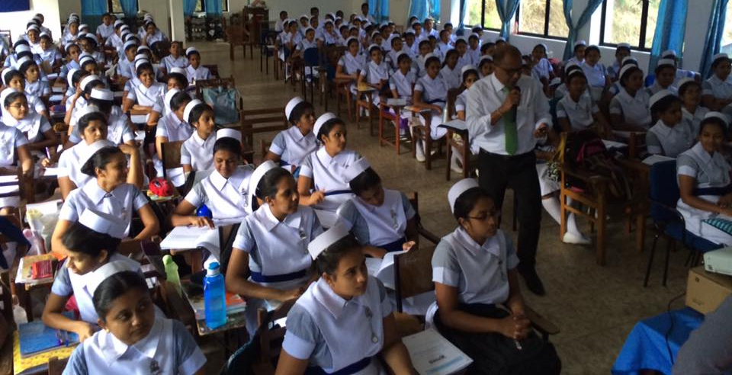
Basic Training of Nurses State Nursing Training Schools
Standardized 03 year curriculum
Clinical placement in State hospitals
Curriculum updates and access to new knowledge –
24 Modules – 1731 hours of theory & 3731 hours of clinical placements
Delivery
Delivery – 100% Face-to-face
Average students per classroom : 148
Total tutoring staff – 269 tutors (AHB, 2015)
Student to tutor ratio – 30:1
Access to library and other facilities – questionable
Assessment
Total paper-based
Mobility of tutors and examiners every semester
Clinical Placement
Preceptorship done by the same tutors
Health and safety of students and staff
Hence the Frugal Environment

Slide 7
Continuous Nursing Education (CNE)- Sri Lanka
CNE
Post basic, clinical specializations at PBS
In- service education , hospital based
Top – up bachelors and Masters in Nursing programmes
Conferences and workshops

Slide 8
Gaps in Continuous Nursing Education (CNE) in Sri Lanka and Maldives
Workload
Accessibility
Administrative
Professional
Personal and Family
Geographical
Affordability
Quality and restrictions of programmes
Sustainability
Hence the Frugal Environment

Slide 9
The innovative Solution ; the project – e-Incubator

Slide 10
IIHS Vision – “The Transformers”
“To Transform People, Community and the Landscape through Innovation”

Slide 11
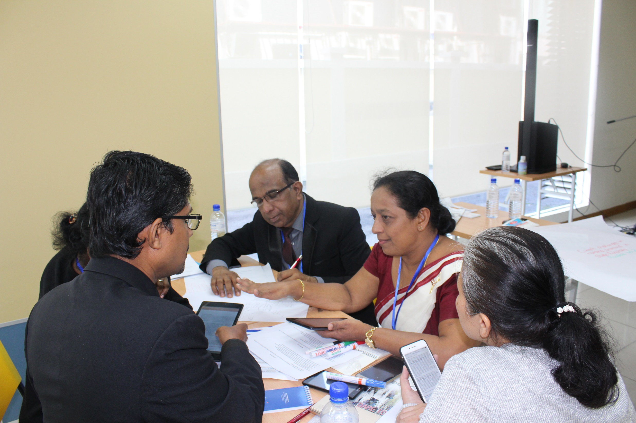
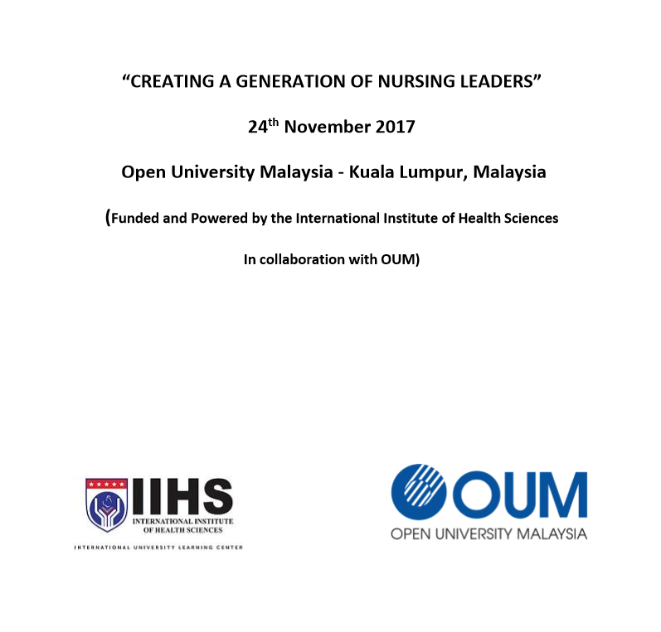
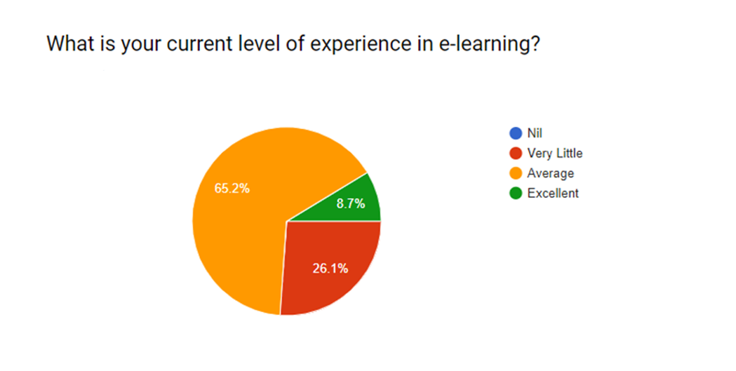
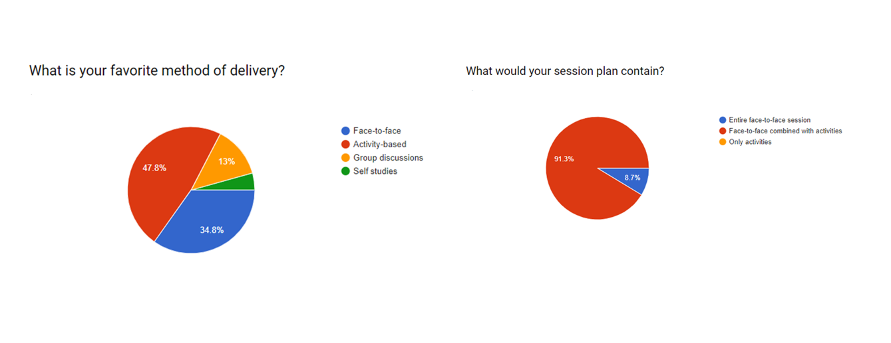
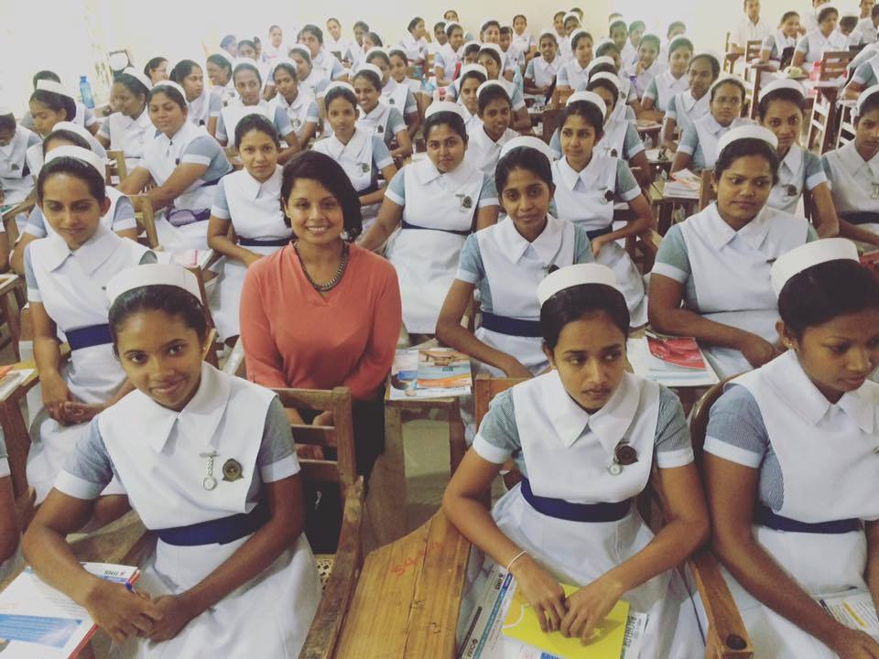
Feasibility Perception of the Users
Study on Nursing administrators – 2017
Recognizing e-learning as an essential component and a solution to current gaps in training in both Basic and CNE
Study conducted on tutors – 2018
Pilot project – 2017
“Research road show”
Positive perception of the Nursing students and tutors
Almost 100 % has the access to digital devices and internet
60% usage of the e-Incubator platform during their final year of study

Slide 12
Project Objectives
Development and implementation of LMS for all State nursing schools in Sri Lanka with a view to augment the quality of basic nurses training, improving staff/student satisfaction & comfort in 2018, whilst adhering to environmental stewardship.
Promotion of the use of LMS & digital devices with a view to improve quality and accessibility of practicing nursing on Continuous Nursing Education (CNE) in Sri Lanka and Maldives in 2018.

Slide 13
The products : Education support for Basic Nursing Training and Practicing nurses
E-Incubator
Basic Nursing Training in NTS
01
CPD
Clinical specialties
03
Top up Bachelors Sri Lanka
02
Top up Bachelors Maldives
02

Slide 14
Description of e-Incubator
URL :
www.iihs.edu.lk
www.iihsnts.edu.lk
: Constructed on Moodle 2.9 version
: The preferred hosting platform for LMS and Moodle
* Supplemented by social media platforms and multiple plugins

Slide 15
Project concept : Aligning with UN SDGs and Nursing now
10- Reduced Inequalities
4- Quality Education
3- Good Health and Well-being
15- Life on Land
17- Partnerships for the Goals

Slide 16
Establishing Public Private Partnerships
Stakeholders
International Institute of Health Sciences (IIHS)
Bio-Inquirer
Practicing nurses in Sri Lanka and Maldives
Sri Lanka Nursing Association (SLNA)
Government and Private Hospitals

Slide 17
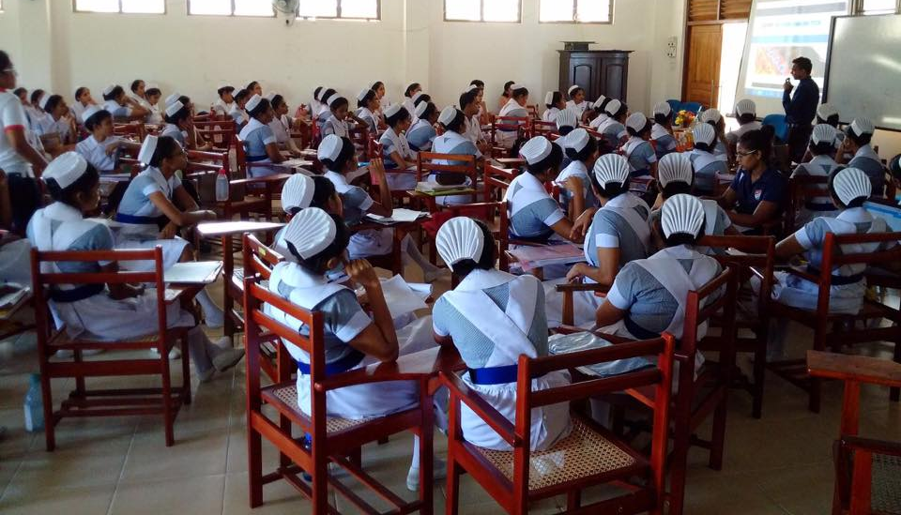
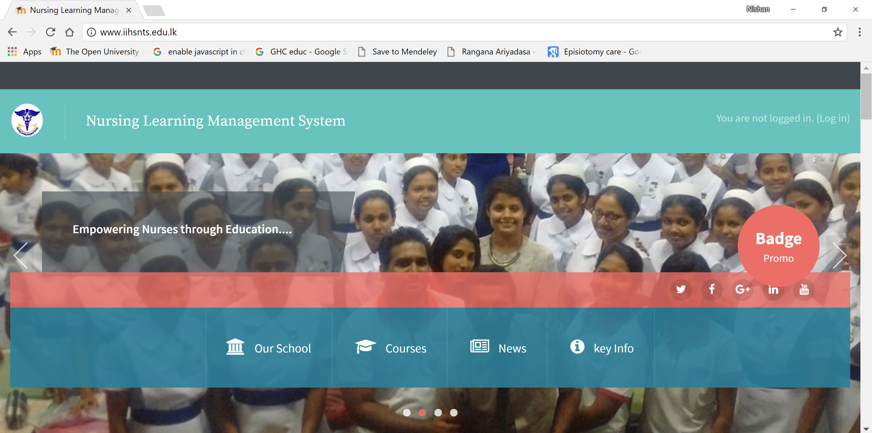
e-Incubator – product 01- NTS: Diploma in General Nursing

Slide 18
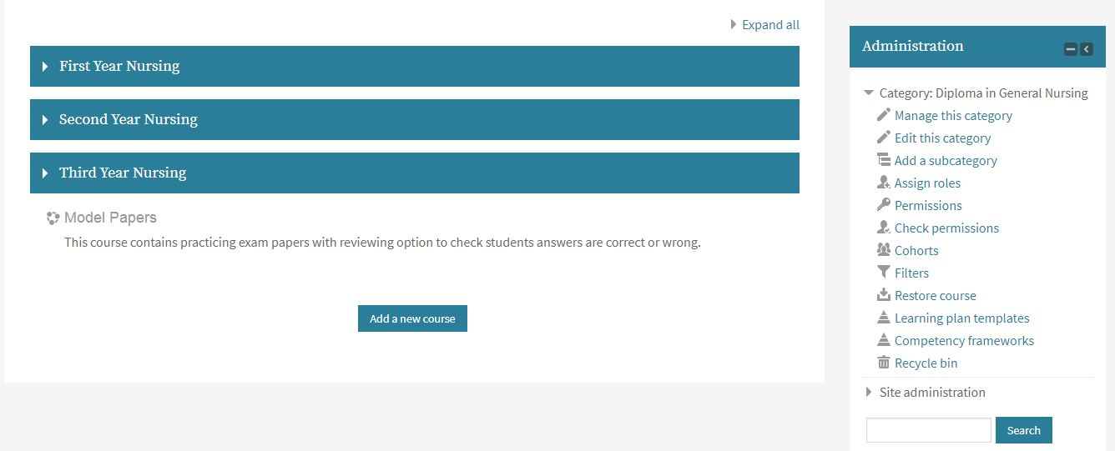
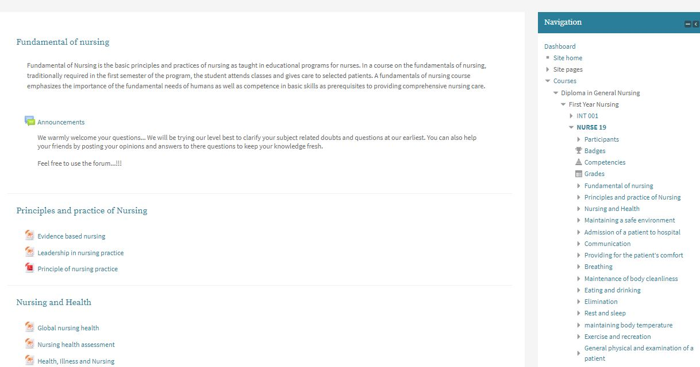
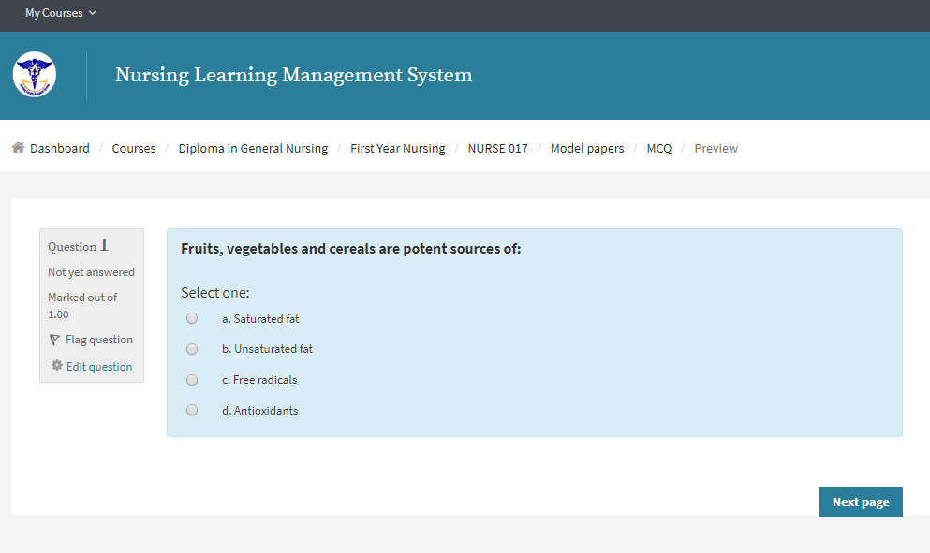
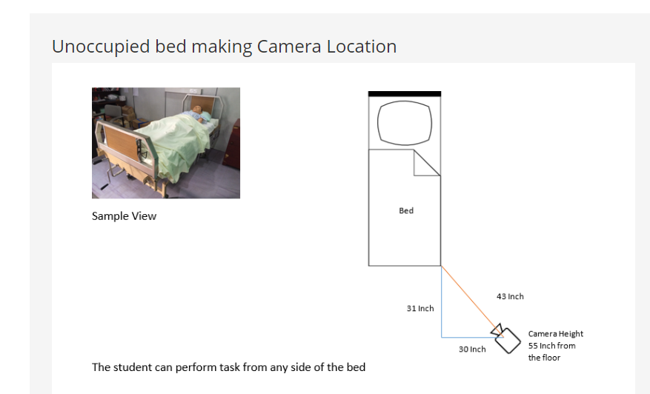
E-Incubator Product 01 –NTS
Augment the delivery of the programme
Resource material provider
Communication with the tutor
Administration of the programme
Noticeboard
Examination
MCQs
Clinical Preceptorship
www.iihsnts.edu.lk
Free of charge

Slide 19
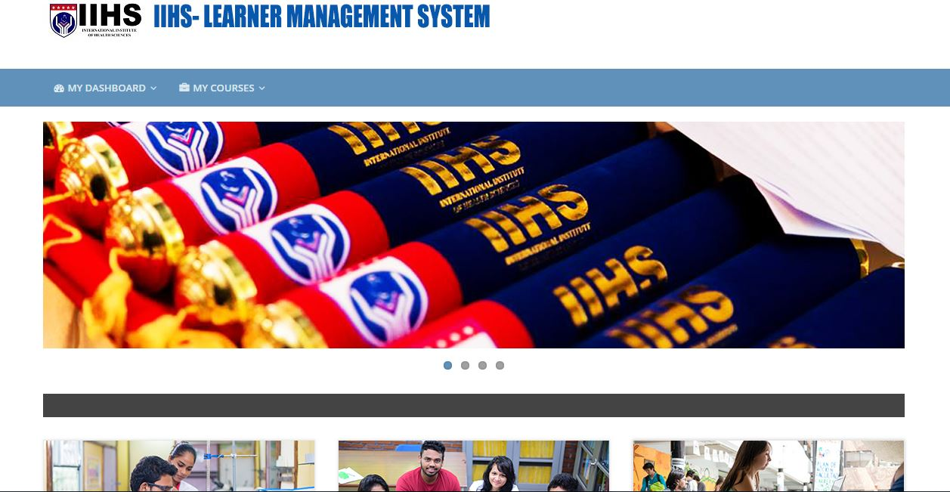
e-Incubator – product 02 –CNE : Top up Bachelors in Nursing

Slide 20
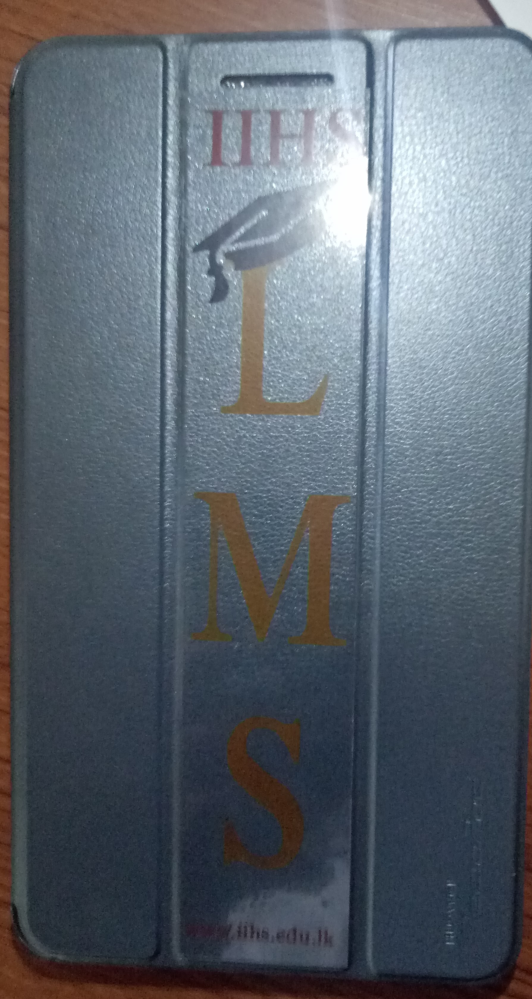
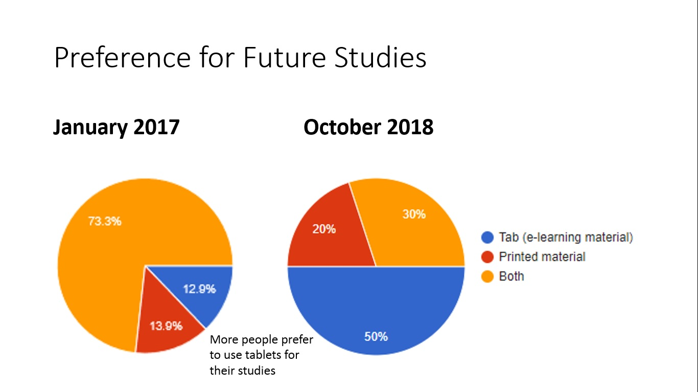
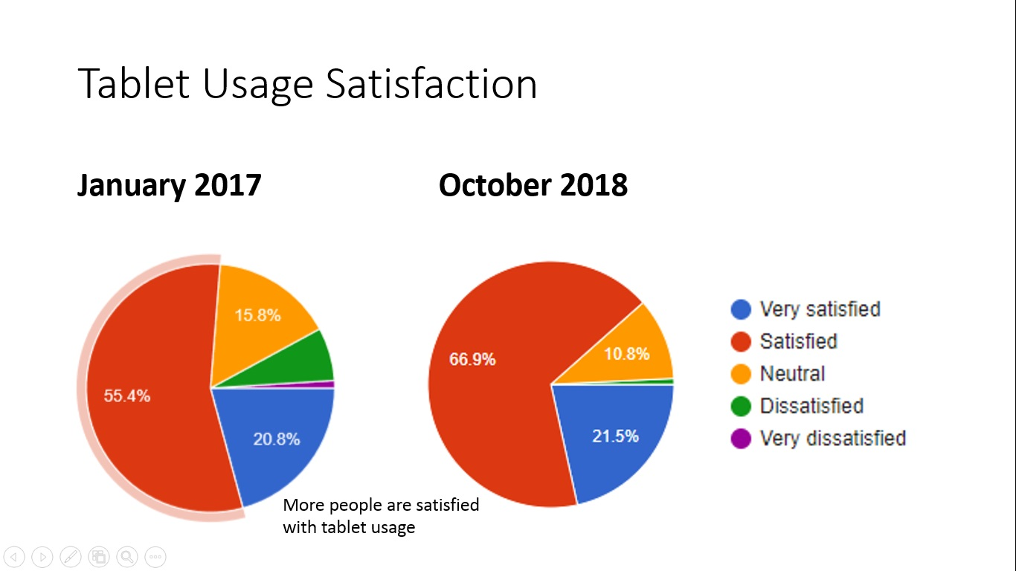
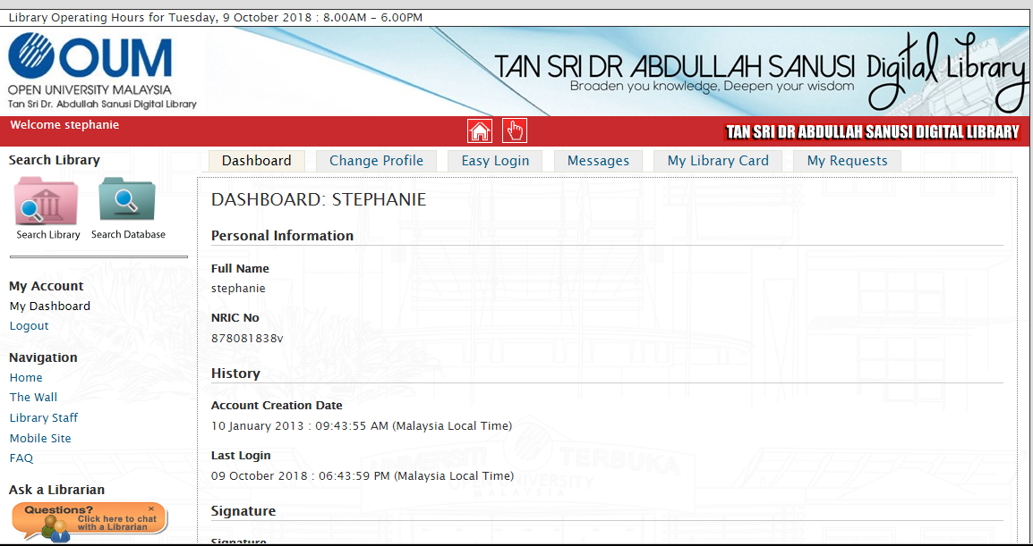
Top up Bachelors- Sri Lanka
Work and study
Two-year programme
Delivery
All books have been replaced by over 1000 tabs
Hybrid method of learning
Two, face-to-face/synchronized lectures fortnightly
LMS – local and access to international e-library
Assessment
All assignments submited online
All MCQs online – in a controlled environment
www.iihs.edu.lk
Fees charged
International nursing degree in Sri Lanka

Slide 21
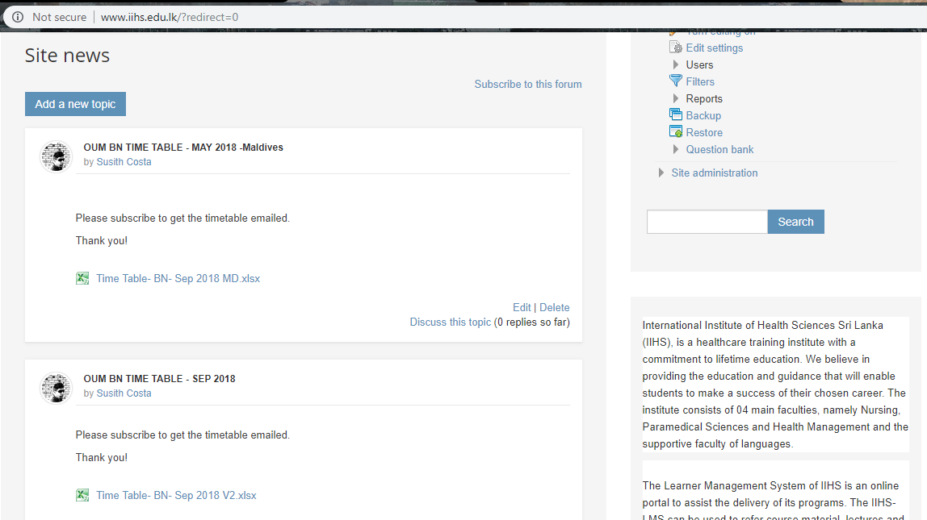
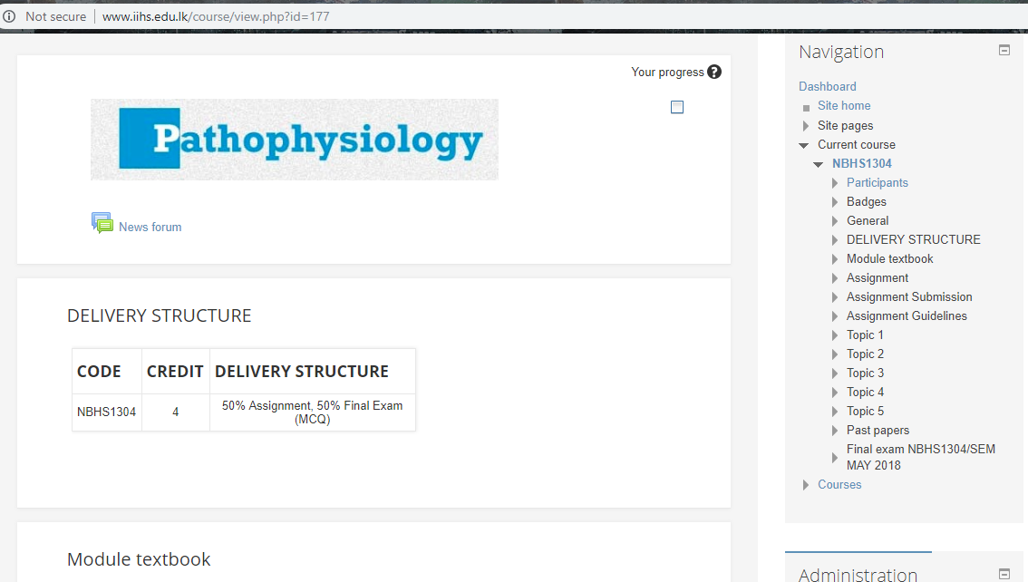
Top up Bachelors- Maldives
Work and study
Hybrid method of learning
Two-year programme
Delivery
Face-to-face/ – 1 week per semester
synchronized lectures every other week
All books have been replaced by tabs
LMS – local and access to international e-library
Assessment
All assignment submissions online
All MCQs online - controlled environment
www.iihs.edu.lk
Improving accessibility/ International nursing degree in Sri Lanka

Slide 22
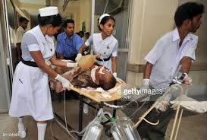
e-Incubator – product 03-CNE : Clinical Specializations

Slide 23
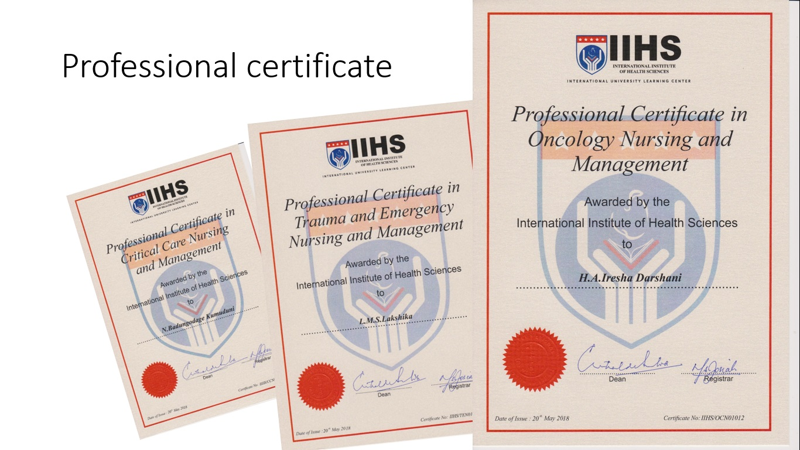
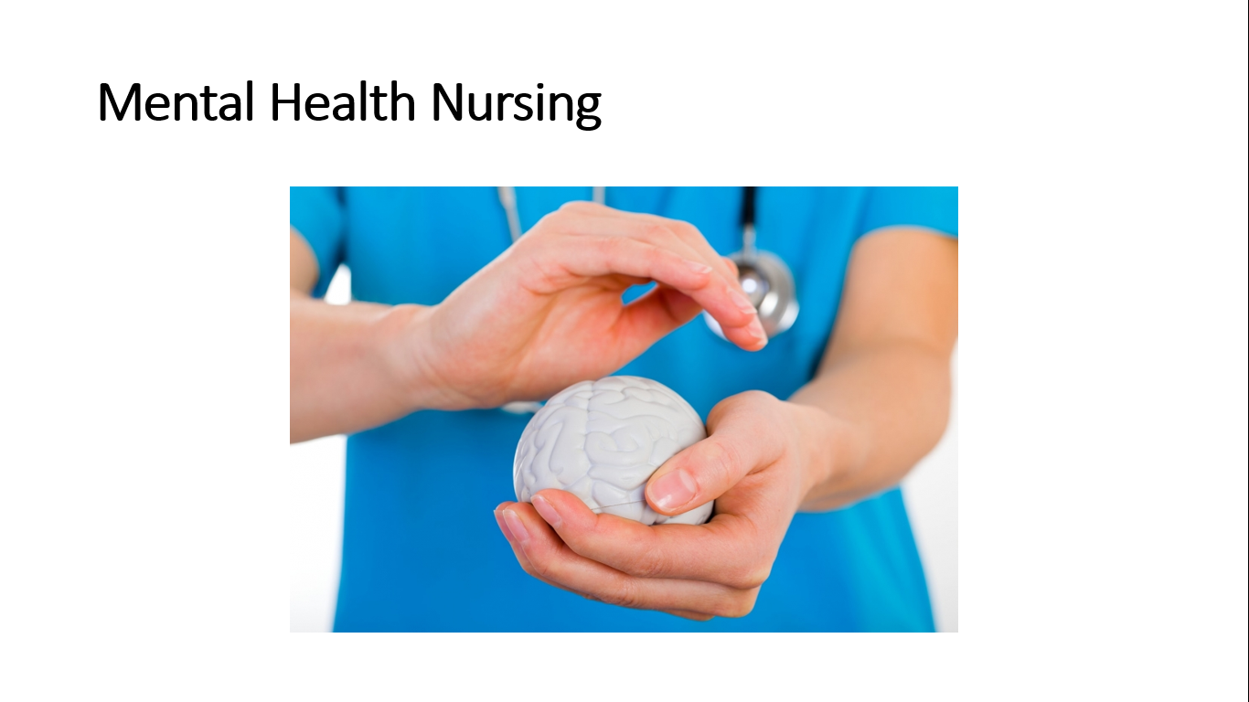
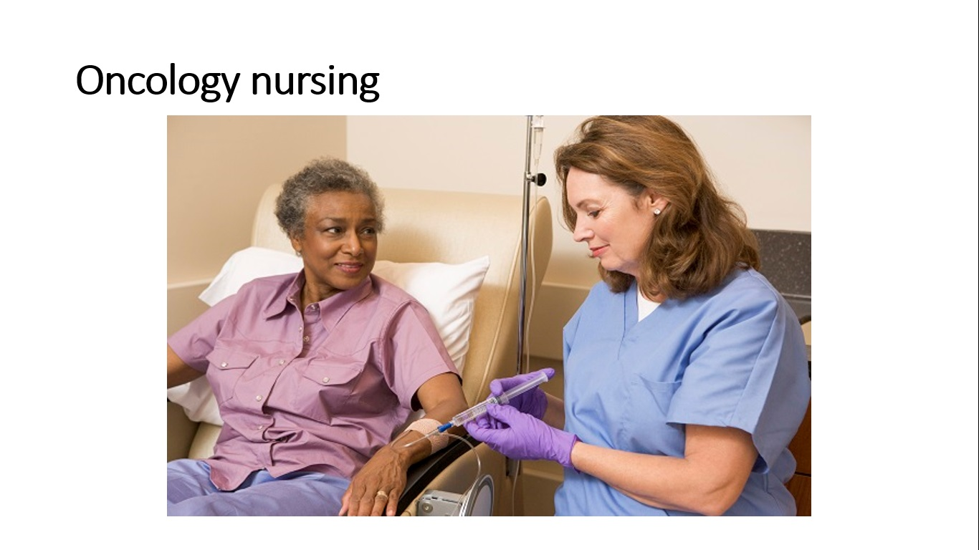
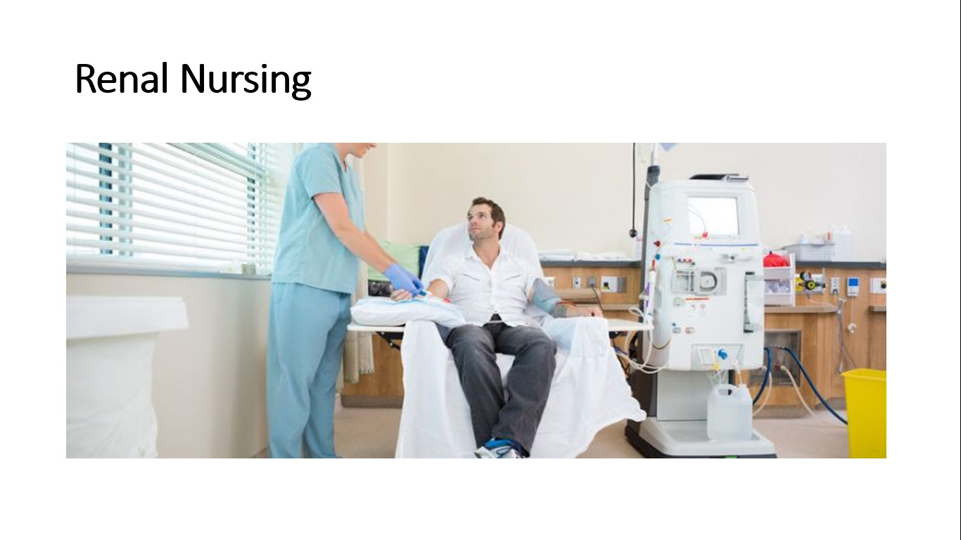
e-incubator- CPD
Work and study
Hybrid learning
6-month clinical specialization
3 synchronized sessions
Delivery, assessment, clinical placement records through LMS
Professional certificate
Free of charge

Slide 24
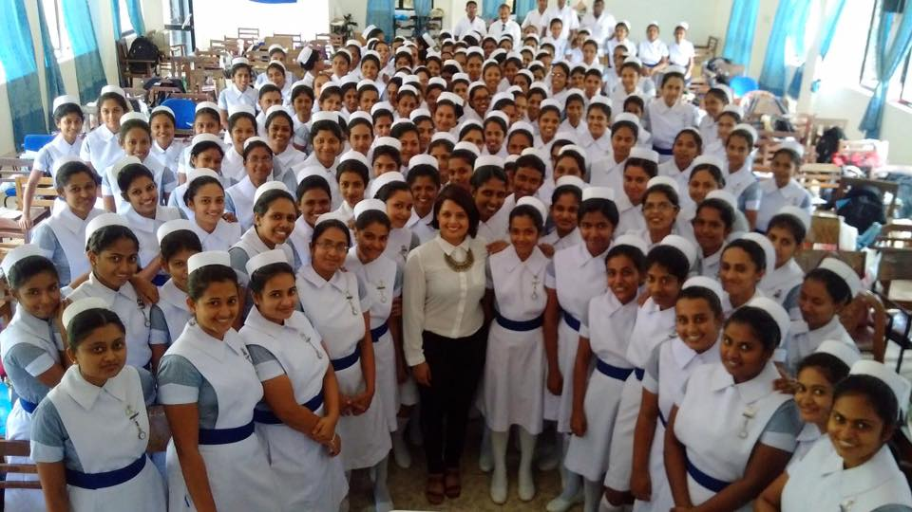
Outcome of e-Incubator
Augmenting the training of 8000 nursing students in the state sector by 2020
Opportunity to address CPD needs of 32,000 working nurses by 2030
Improving Accessibility to high quality higher education qualifications to Sri Lankan and Maldivian nursing professionals BNS / MN , 2020 – (10% nursing population in Sri Lanka Maldives)
Improving the Efficiency of Education
Add Cost Effectiveness to education
Environmental Sustainability

Slide 25
Quantification of the Outcome – product 02
Estimate for 100 students of BNS
Assessments
Printing of assignment questions, exam papers and answer booklets – 1170X 100 = 117,000 SLR
Cost of paper marking ( MCQ ) – 1900 X 100 = 190,000 SLR
Assignment printing = 3500 X 100 = 350,000 SLR
Total cost saving for 100 students = 3,379,000
Total printing of papers avoided = 5057 X 100= 505,700
Delivery
Nominal hours – 4822
Standard Face-to-face – 1206 hours
Hybrid learning - 396 hours ( 67.2% reduction )
Cost saving – 810 X 2200 = 1,782,000 SLR
Use of study guide books – 19 X 220 = 4180 X 100 = 418,000 pages : Book cost – 2,340,000 SLR
Cost saving from a tablets – 2,340,000 – 1,400,000 = 940,000 SLR

Slide 26
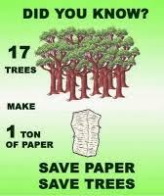
Project impact Sustainability & funding to product 01 and 03
Total cost saving for 100 students – 3, 379,000
Total printing avoided – 5057 X 100 = 505,700
Saving 33 trees
Total saving from 1000 students
33.7 million SLR – Funds for product 01 & 3
330 trees
Excluding
Impact of digital library saving
Library books – 1000X 10 = 10,000
Paper – 200 X 10,000 = 2, 000, 000
Saving 133 trees and SLR 35,000,000
House hold cost of students – traveling, food & lodging, etc.

Slide 27
3. Way Forward

Slide 28
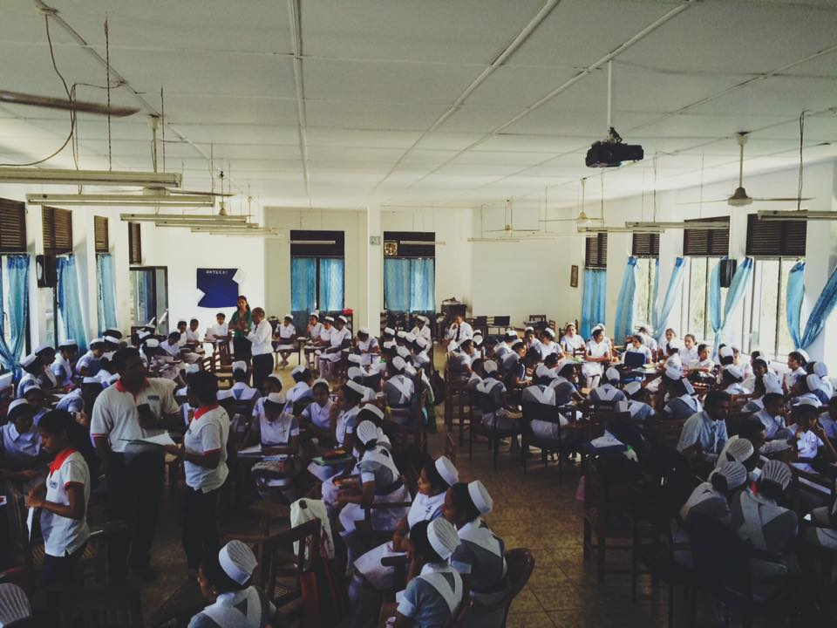
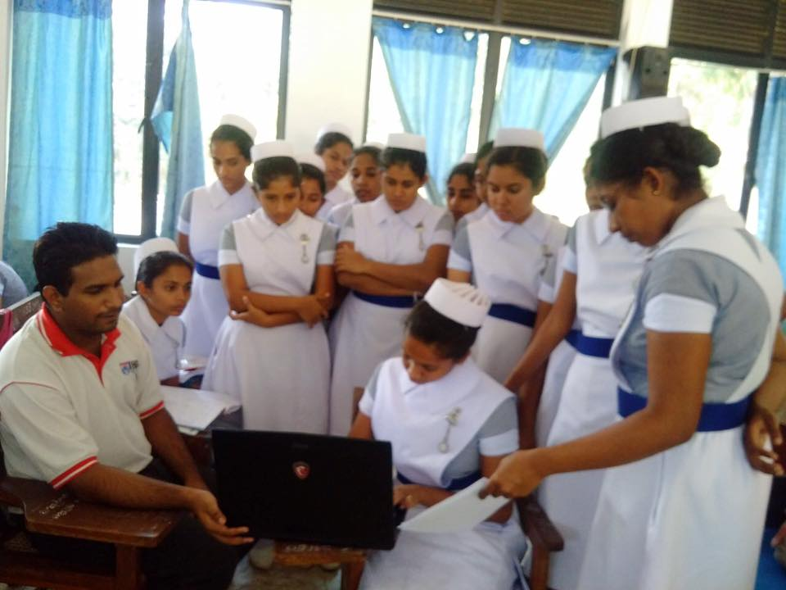
Way forward supporting Frugal environment
Product 01 :
NTS - Reduce face-to-face sessions by 30% by 2020
NTS - All MCQs and assignment submissions conducted online by 2021
NTS - Standardized delivery and assessments by 2022
Product 02 & 03
Expand CPD and top-up Bachelors programmes to other regional countries
e-Resource centers in hospitals and nursing schools – searching for funding

Slide 29
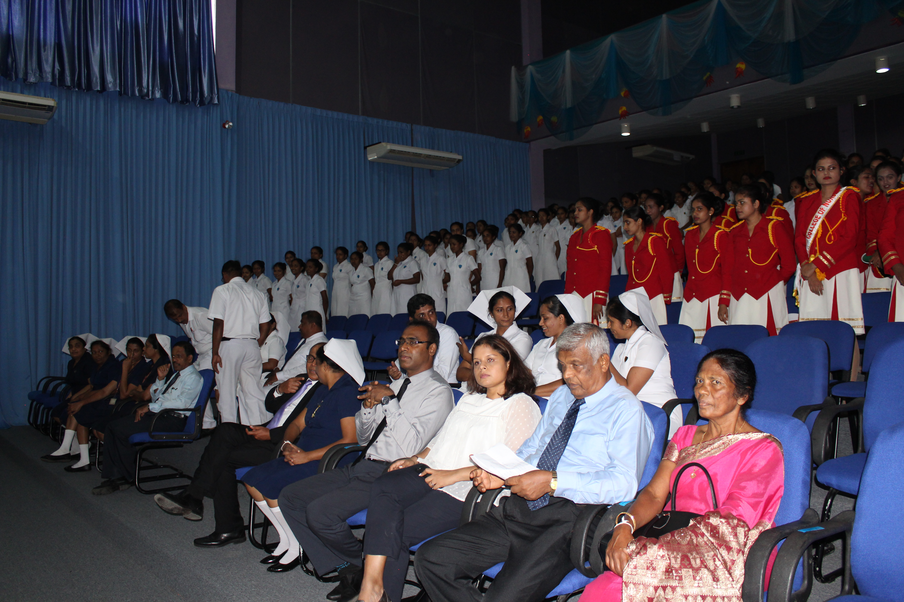
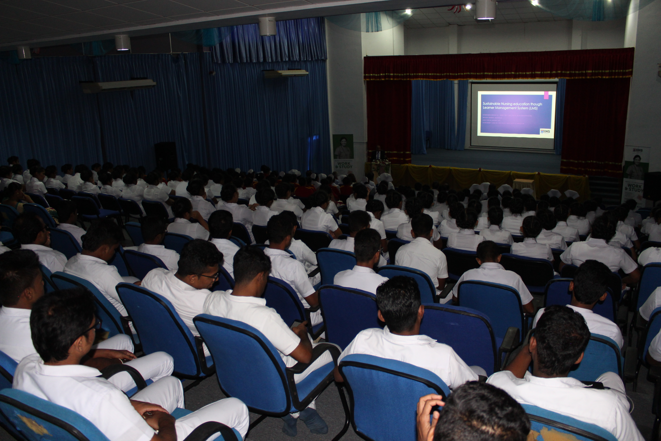
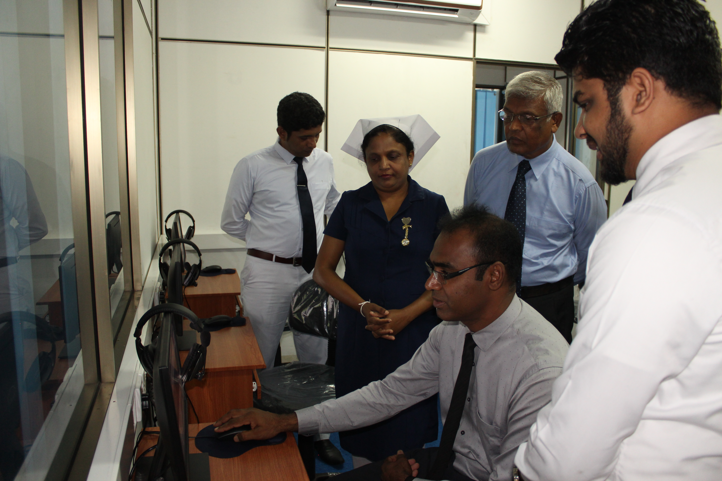

Slide 30
Thank you !

