Slide 1
Contribution of the private sector to improve the image of the Nurse in South Asia

Slide 2
Population in South Asia – 1.891 Billion = nearly ¼ of world’s population
Nurses in South Asia – 3.143 Million
Nurse patient ratio in South Asia – 1:600
(WHO, 2019)

Slide 4
Around 44,000 nurses in Sri Lanka (as a ratio - 1:480)
(Department of Census and Statistics, 2017)
Nurses’ workload
Expected – 36 hrs per week
Actual – over x2 (>72 hrs)

Slide 5
55 million OPD visits
27 million clinic visits
7 million inpatient visits
(c. 90 million visits annually)
(c. 250,000 patients everyday)
(Annual Health Statistics, 2017)

Slide 6
What do Nurses Require?
More clinical knowledge
More hands-on skills in specialized areas
Better critical thinking abilities
Better problem solving skills
Good communication skills
To practice based on evidence

Slide 7
Nurses with a degree or above
5% – 7.5% (2,000 - 3,000)
Every 10% increase in nurses with Bachelor degrees, the likelihood of patient mortality fell by 7% in hospital settings
(National Institute of Health, 2014)

Slide 8
Upgrading Nurses: Current Gaps in Continuous Nursing Education (CNE)
Workload
Culture - Value for CNE?
Accessibility
Professional
Personal and family
Geographical
Administrative
Affordability
Sustainability
Quality and the outcome of programs

Slide 9
Smart Revolution
Workload
Hybrid learning (both face-to-face and e-learning)
Saving time (less traveling, less F2F lectures, etc.)
Accessible
Learn from anywhere, at anytime – LMS

Slide 10
Affordable
Less F2F → less cost (both personal and institutional)
Balanced life
‘Work, Study & Family’ concept

Slide 11
Beginning of a Smart Revolution

Slide 12
Accessibility

Slide 13
BioInquirer – Global Research Hub

Slide 14
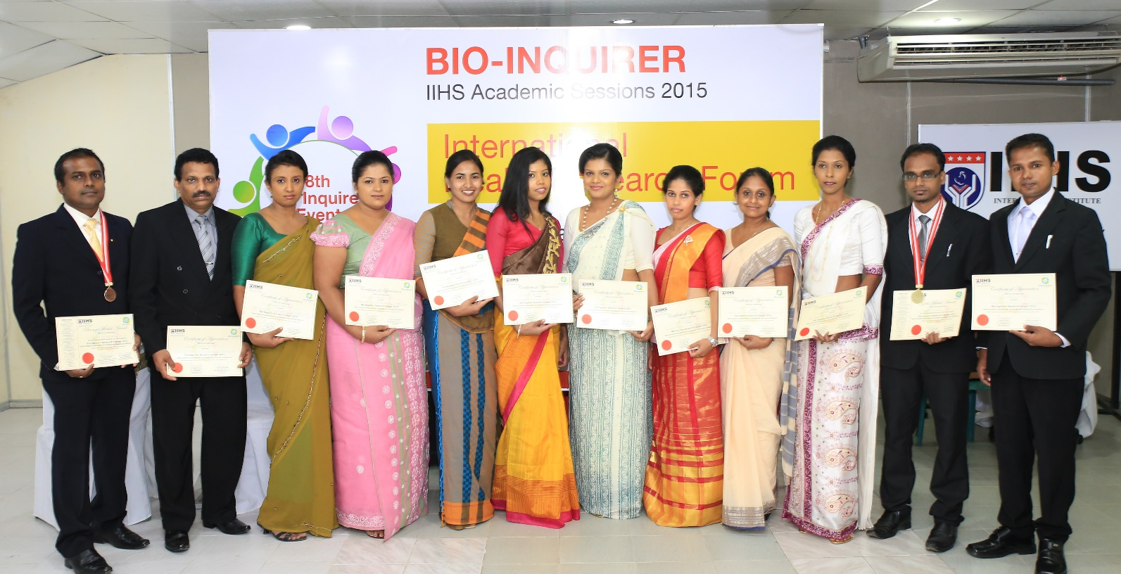
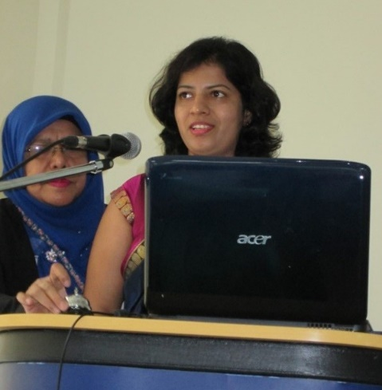
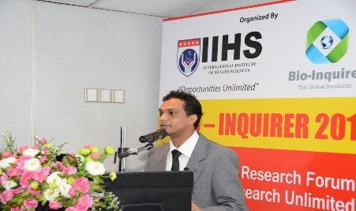
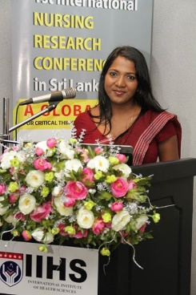
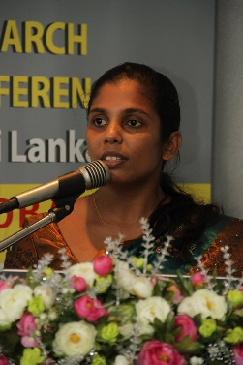
Research Publications
Value addition for Nurses

Slide 15
Smart Learning
Healthcare professionals in Sri Lanka lack skills in ICT and are faced with the challenge of grasping technology
In order to overcome this, they should familiarize themselves with the basic use of electronic devices
The use of electronic devices such as tablets is an effective way to encourage familiarization with ICT
(Gunawardana, 2007)

Slide 16
(p=0.045) the difference is statistically significant
Notes:
With regards to the preferred method for future studies, majority stated that they would prefer using tabs over books, however, there is a statistically significant difference between age and the preference of tabs over books

Slide 17
Notes:
Nearly all participants stated that using a tab would contribute to enhancing their professional growth. The table shows that the majority were satisfied and very satisfied with the use of tabs

Slide 18
Beginning of a new Era in education
Crowning as the best learning platform for 3 consecutive years.

Slide 19
IIHS Learner Management System
Total BN and MN professionals
Total number of IIHS – LMS users of Nursing sector in Sri Lanka
1842 users

Slide 20
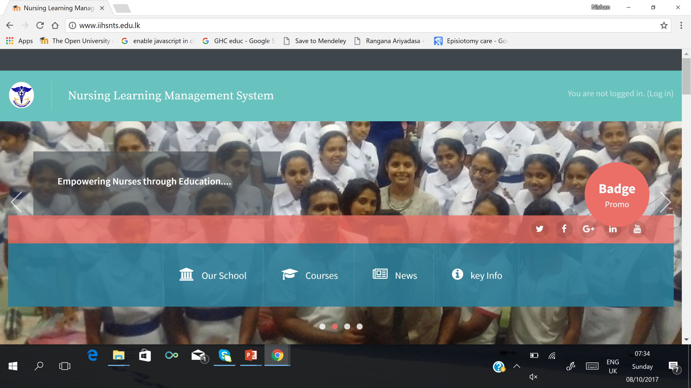
Excelling our E arm for the betterment of Gov. Nursing sector
NTS - LMS

Slide 22
For the past 3 years…
IIHS has reached more than……
6500 Nurses in South Asia….

Slide 23
Are we done?
Are we tired of helping?
“TIRED” IS A WORD THAT WE HAVE REMOVED FROM OUR VOCABULARY

Slide 24
World’s Plan for 2020…
Continuous Professional Development (CPD) for Nurses…
CNMF suggests to start this as an online learning methodology to improve the image and professionalism in nursing sector from 2020…
BUT……
Even before CNMF thinks……WE HAVE DONE IT!!!

Slide 25
IIHS Global – e-Incubator

Slide 26
10 CPD modules for all the nurses in the world
Professional Certificate in Renal Nursing
Professional Certificate in Oncology Nursing
Professional Certificate in Pediatric Nursing
Professional Certificate in Emergency and Trauma Nursing
Professional Certificate in Mental Health Nursing
Professional Certificate in Critical Care Nursing
Professional Certificate in Wound Management
Professional Certificate in Nursing Informatics
Professional Certificate in Operation Theatre Nursing
Professional Certificate in English Language

Slide 27
Thank You!
Service to others is the rent you pay for your room here on earth!
(Mohammed Ali 1942-2016)

